Slide 1
Lecture 3
ITEC618
Program Control Structures: Selections and Loops I
Programming Concepts
Lecturer: Dr. Farshid Keivanian

Slide 2
Motivations
If the radius is negative, you don't want the program to compute the area. How can you deal with this situation?
Selection statements!

Slide 3
The boolean Type and Operators
Often in a program you need to compare two values, such as whether i is greater than j. Java provides six comparison operators (also known as relational operators) that can be used to compare two values. The result of the comparison is a Boolean value: true or false.
boolean b = (1 > 2);

Slide 4
Relational Operators

Slide 5
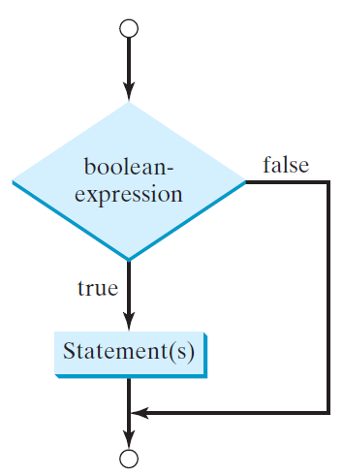
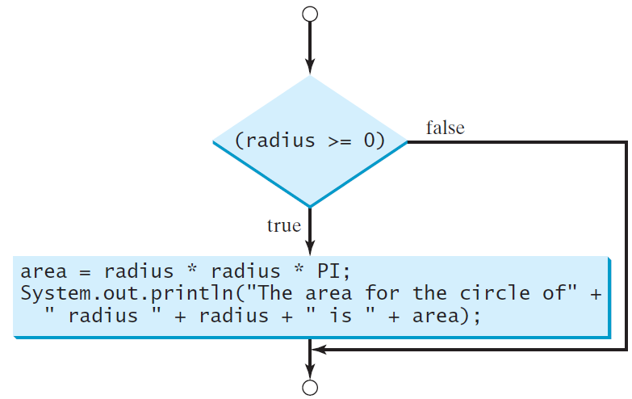
One-way if Statements
if (radius >= 0) {
area = radius * radius * PI;
System.out.println("The area"
+ " for the circle of radius "
+ radius + " is " + area);
}
if (boolean-expression) {
statement(s);
}

Slide 6
Note

Slide 7
Simple if Demo
Write a program that prompts the user to enter an integer. If the number is a multiple of 5, print HiFive. If the number is divisible by 2, print HiEven.
SimpleIfDemo

Slide 8
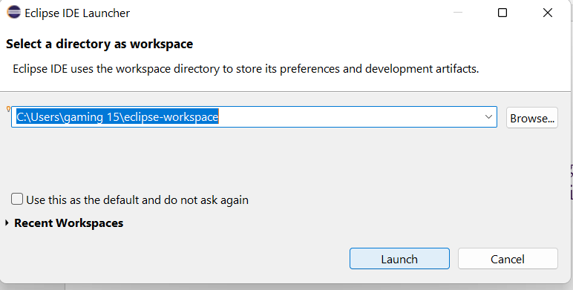

Slide 9
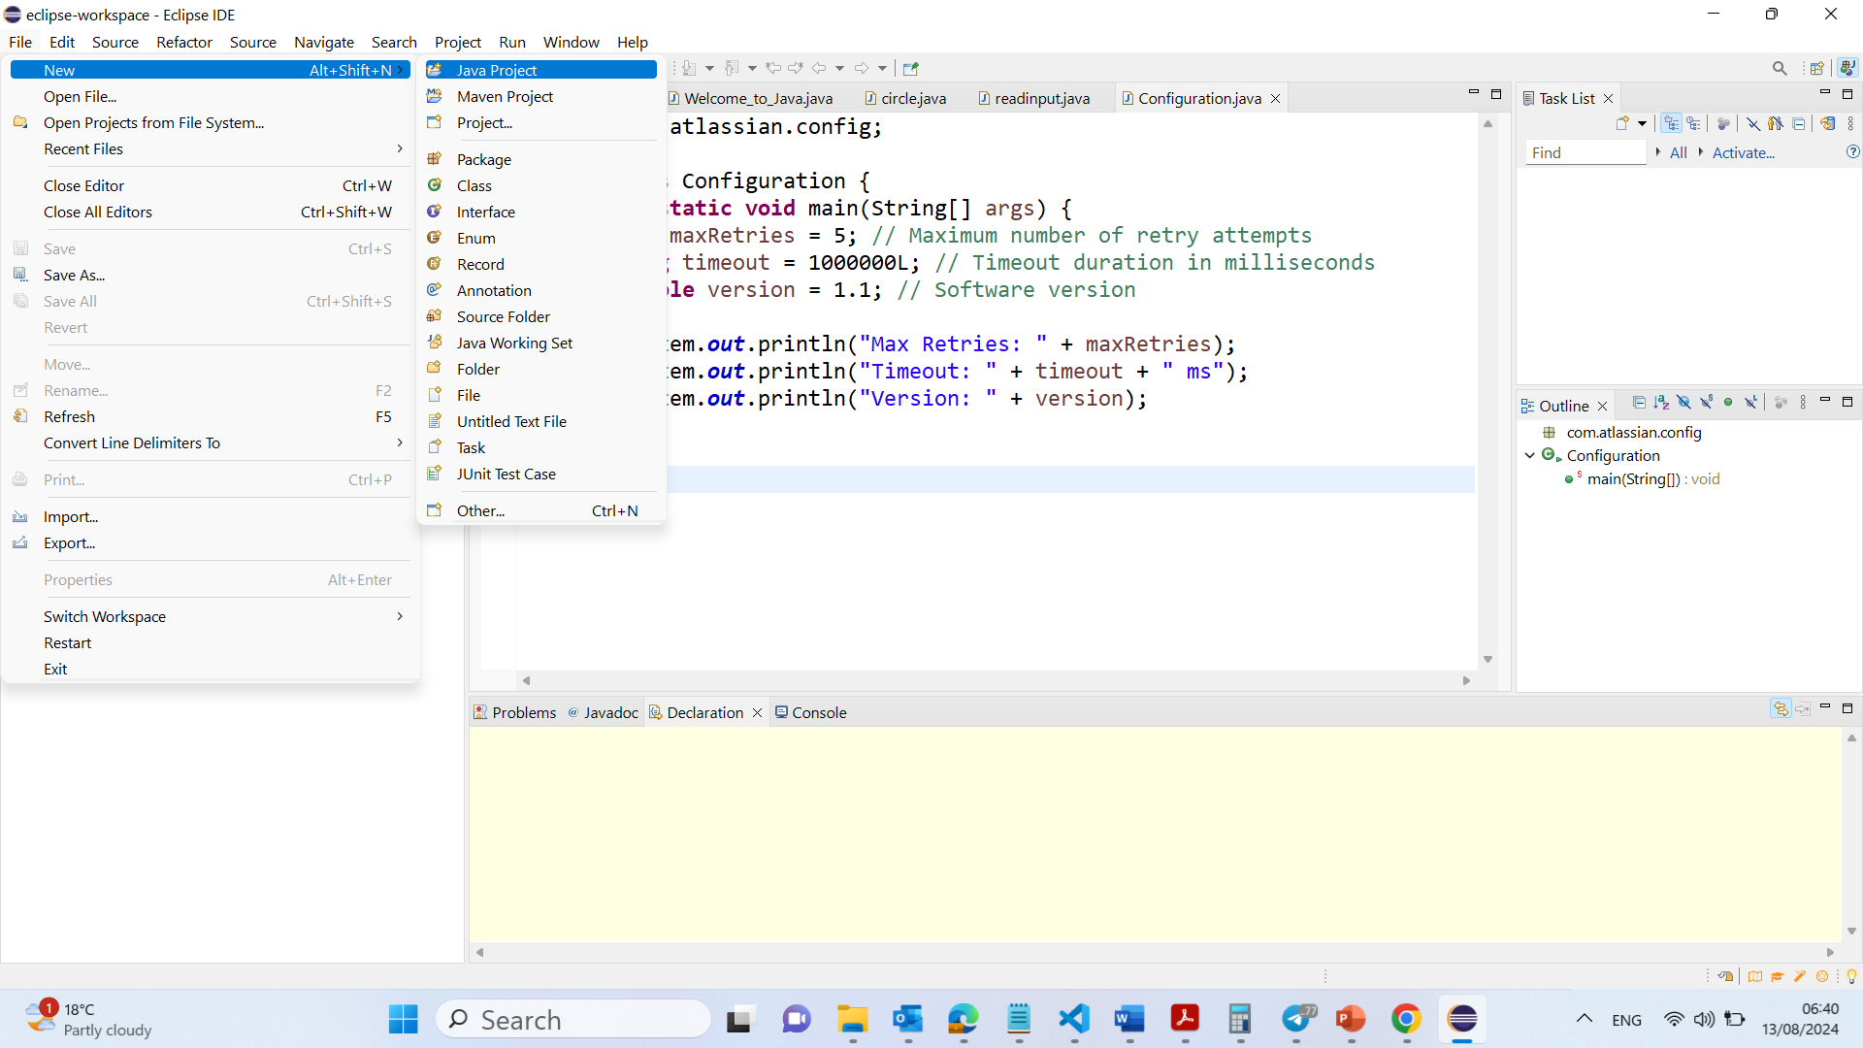

Slide 10
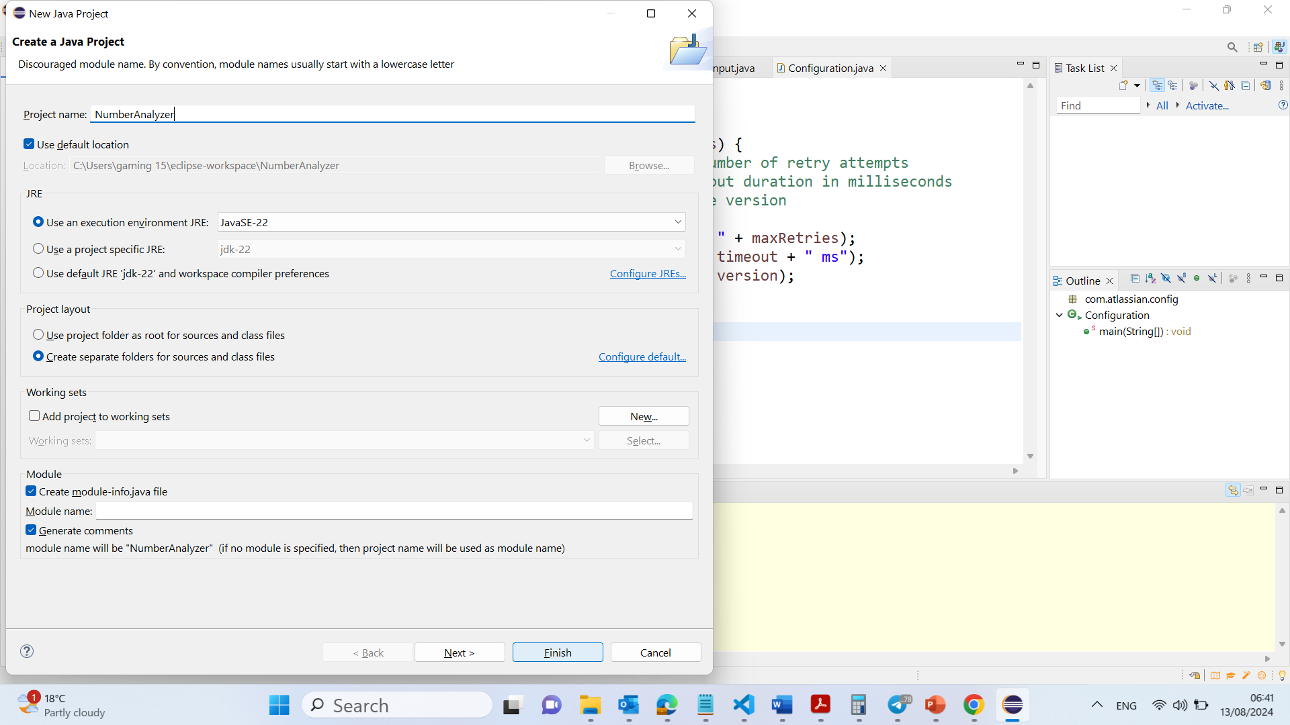

Slide 11
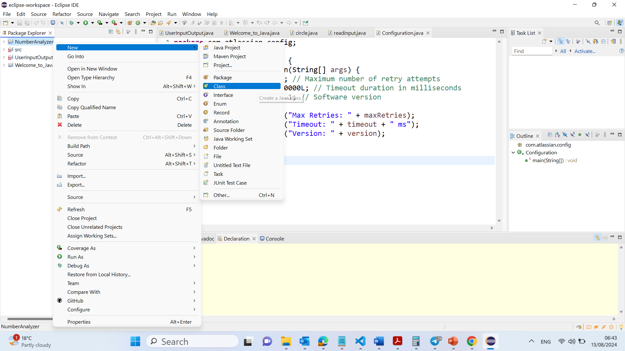

Slide 12
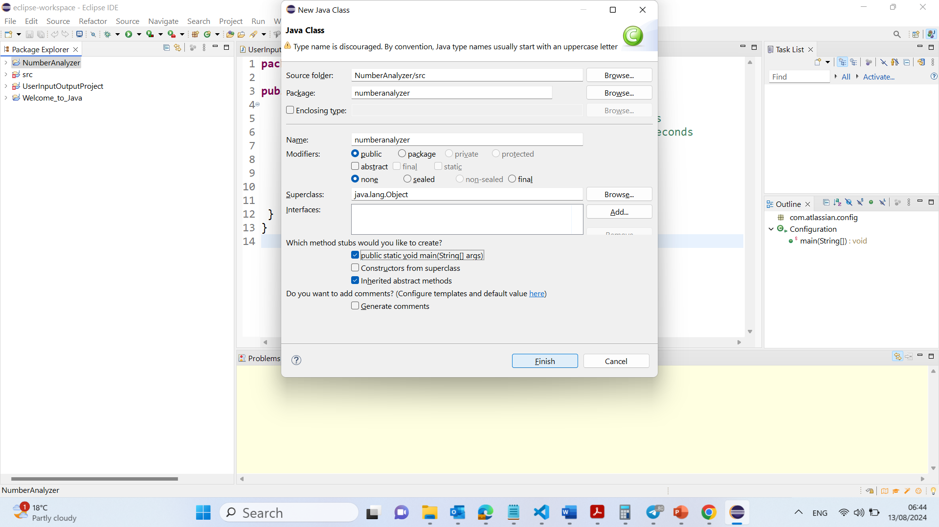

Slide 13
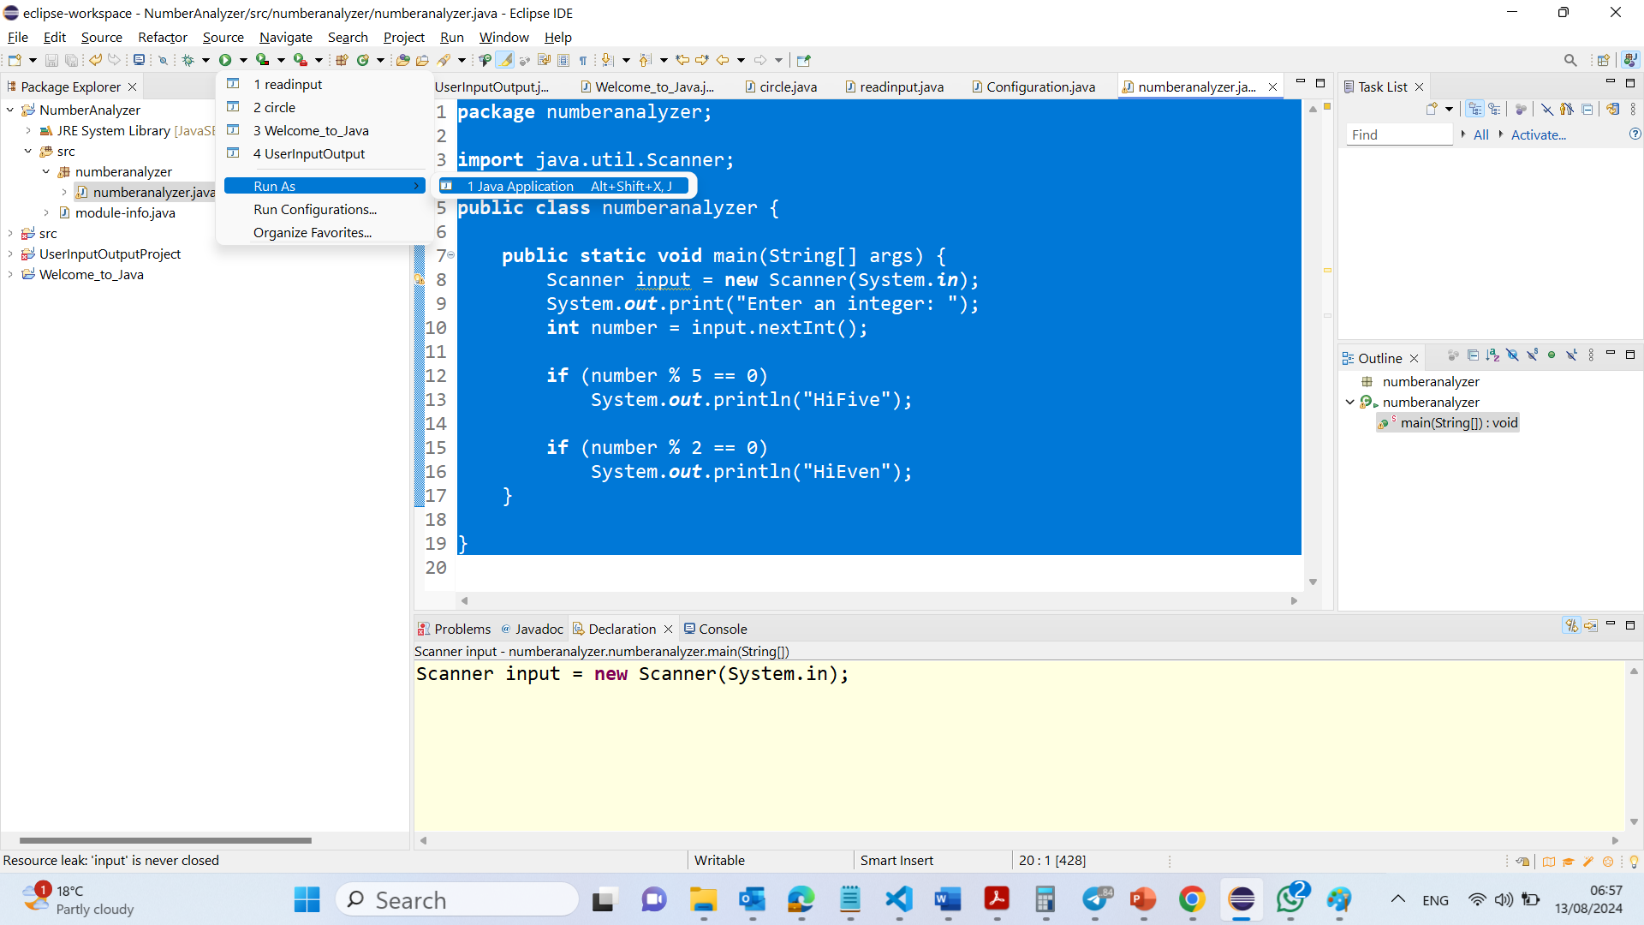

Slide 14
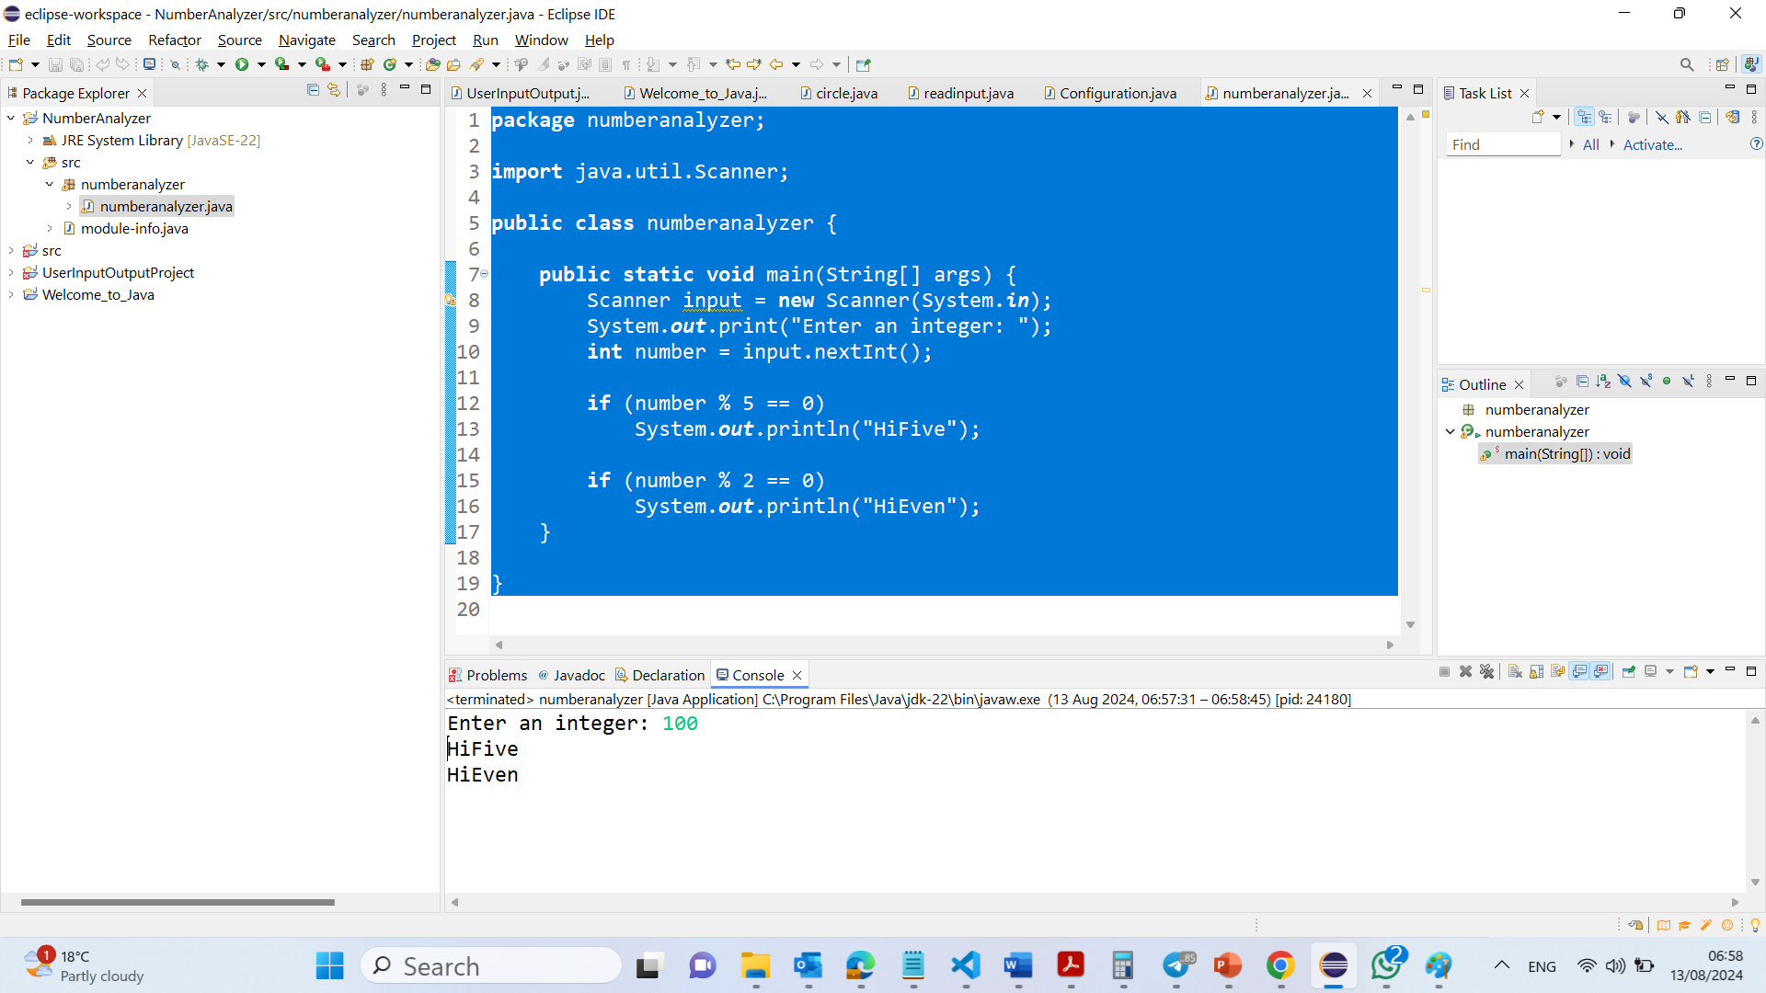

Slide 15
package numberanalyzer;
import java.util.Scanner;
public class numberanalyzer {
public static void main(String[] args) {
Scanner input = new Scanner(System.in);
System.out.print("Enter an integer: ");
int number = input.nextInt();
if (number % 5 == 0)
System.out.println("HiFive");
if (number % 2 == 0)
System.out.println("HiEven");
}
}
1. Package Declaration: This line defines the package for the class. A package in Java is a way to organize related classes and interfaces. The numberanalyzer package means that this class belongs to a directory or folder named numberanalyzer. It helps in avoiding name conflicts and makes it easier to manage large projects

Slide 16
package numberanalyzer;
import java.util.Scanner;
public class numberanalyzer {
public static void main(String[] args) {
Scanner input = new Scanner(System.in);
System.out.print("Enter an integer: ");
int number = input.nextInt();
if (number % 5 == 0)
System.out.println("HiFive");
if (number % 2 == 0)
System.out.println("HiEven");
}
}
2. Import Statement: This line imports the Scanner class from the java.util package. The Scanner class is used for obtaining input from various input sources like the keyboard. By importing this class, you can use it in your program to read user input.

Slide 17
package numberanalyzer;
import java.util.Scanner;
public class numberanalyzer {
public static void main(String[] args) {
Scanner input = new Scanner(System.in);
System.out.print("Enter an integer: ");
int number = input.nextInt();
if (number % 5 == 0)
System.out.println("HiFive");
if (number % 2 == 0)
System.out.println("HiEven");
}
}
3. Class Definition: This line declares a public class named numberanalyzer. In Java, a class is a blueprint for creating objects. The public keyword means that this class is accessible from other classes in different packages. The class name numberanalyzer should follow Java naming conventions (usually, class names start with an uppercase letter), but it is still valid with lowercase.

Slide 18
package numberanalyzer;
import java.util.Scanner;
public class numberanalyzer {
public static void main(String[] args) {
Scanner input = new Scanner(System.in);
System.out.print("Enter an integer: ");
int number = input.nextInt();
if (number % 5 == 0)
System.out.println("HiFive");
if (number % 2 == 0)
System.out.println("HiEven");
}
}
4. Main Method: - This is the main method, which is the entry point of any Java program. When you run a Java application, the JVM (Java Virtual Machine) looks for the main method to start execution.
- public: The method is accessible from anywhere.
- static: It belongs to the class rather than an instance of the class.
- void: This method doesn't return any value.
- String[] args: This is an array of strings that can store command-line arguments. It is usually left empty when running programs in most basic examples.

Slide 19
package numberanalyzer;
import java.util.Scanner;
public class numberanalyzer {
public static void main(String[] args) {
Scanner input = new Scanner(System.in);
System.out.print("Enter an integer: ");
int number = input.nextInt();
if (number % 5 == 0)
System.out.println("HiFive");
if (number % 2 == 0)
System.out.println("HiEven");
}
}
5. Scanner Initialization:
- This line creates a new Scanner object named input that reads from the standard input stream (keyboard). System.in refers to the input stream from the keyboard.
- The Scanner class provides various methods to read different types of input like integers, strings, etc.

Slide 20
package numberanalyzer;
import java.util.Scanner;
public class numberanalyzer {
public static void main(String[] args) {
Scanner input = new Scanner(System.in);
System.out.print("Enter an integer: ");
int number = input.nextInt();
if (number % 5 == 0)
System.out.println("HiFive");
if (number % 2 == 0)
System.out.println("HiEven");
}
}
6. Prompting User for Input:
This line prints a message to the console asking the user to "Enter an integer." The print method is used instead of println to keep the cursor on the same line after printing the message.

Slide 21
package numberanalyzer;
import java.util.Scanner;
public class numberanalyzer {
public static void main(String[] args) {
Scanner input = new Scanner(System.in);
System.out.print("Enter an integer: ");
int number = input.nextInt();
if (number % 5 == 0)
System.out.println("HiFive");
if (number % 2 == 0)
System.out.println("HiEven");
}
}
7. Reading User Input:
- This line reads an integer input from the user and stores it in the variable number.
- input.nextInt() reads the next integer entered by the user. If the user enters a non-integer value, the program will throw an exception.

Slide 22
package numberanalyzer;
import java.util.Scanner;
public class numberanalyzer {
public static void main(String[] args) {
Scanner input = new Scanner(System.in);
System.out.print("Enter an integer: ");
int number = input.nextInt();
if (number % 5 == 0)
System.out.println("HiFive");
if (number % 2 == 0)
System.out.println("HiEven");
}
}
8. Condition to Check if the Number is Divisible by 5:
- This block checks if the entered number is divisible by 5.
- number % 5 calculates the remainder when number is divided by 5. If the remainder is 0 (number % 5 == 0), the number is divisible by 5.
- If the condition is true, the program prints "HiFive" to the console.

Slide 23
package numberanalyzer;
import java.util.Scanner;
public class numberanalyzer {
public static void main(String[] args) {
Scanner input = new Scanner(System.in);
System.out.print("Enter an integer: ");
int number = input.nextInt();
if (number % 5 == 0)
System.out.println("HiFive");
if (number % 2 == 0)
System.out.println("HiEven");
}
}
9. Condition to Check if the Number is Even:
- This block checks if the entered number is even.
- number % 2 calculates the remainder when number is divided by 2. If the remainder is 0 (number % 2 == 0), the number is even.
- If the condition is true, the program prints "HiEven" to the console.

Slide 24
package numberanalyzer;
import java.util.Scanner;
public class numberanalyzer {
public static void main(String[] args) {
Scanner input = new Scanner(System.in);
System.out.print("Enter an integer: ");
int number = input.nextInt();
if (number % 5 == 0)
System.out.println("HiFive");
if (number % 2 == 0)
System.out.println("HiEven");
}
}
10. Closing the Class and Method:
The closing braces } mark the end of the main method and the numberanalyzer class. Every block of code in Java (like methods, classes, loops, etc.) is enclosed within curly braces {}.

Slide 25
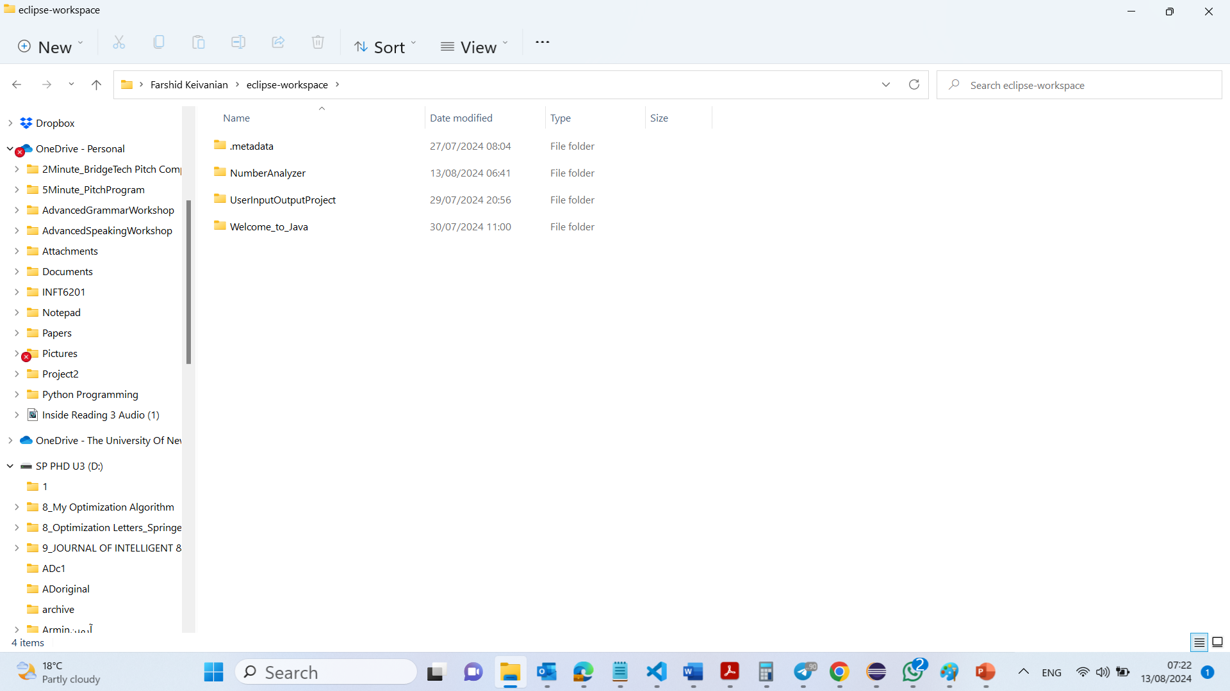
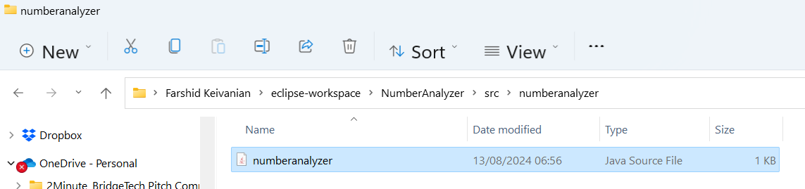
The project will be saved in
C:\Users\...\eclipse-workspace\NumberAnalyzer
The java code will be saved in
C:\Users\...\eclipse-workspace\NumberAnalyzer\src\numberanalyzer

Slide 26
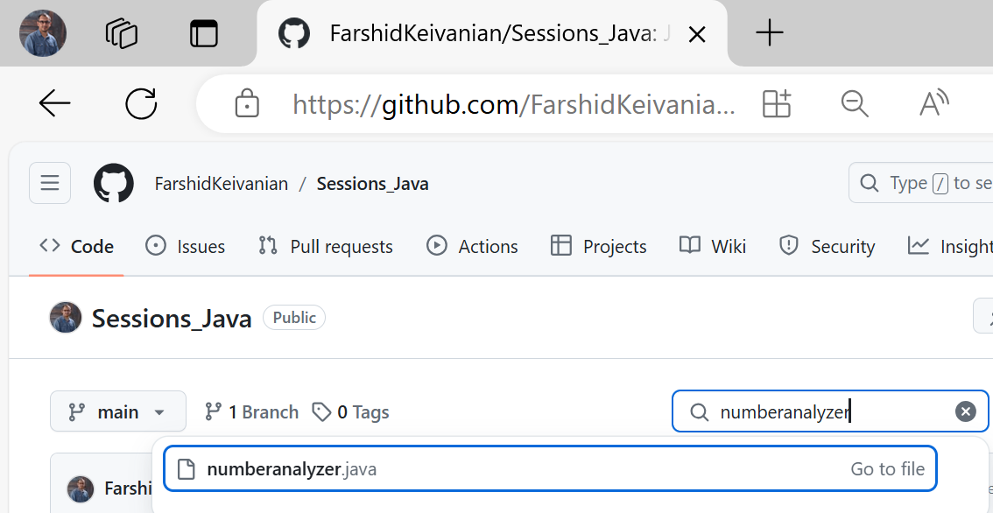
https://github.com/FarshidKeivanian/Sessions_Java

Slide 27
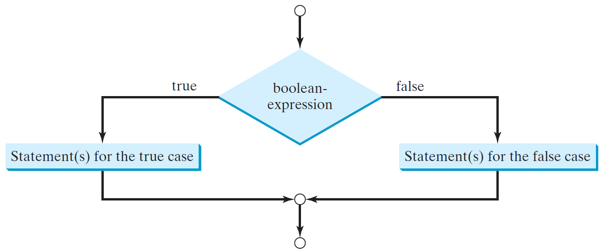
The Two-way if Statement
if (boolean-expression) {
statement(s)-for-the-true-case;
}
else {
statement(s)-for-the-false-case;
}

Slide 28
if-else Example
if (radius >= 0) {
area = radius * radius * 3.14159;
System.out.println("The area for the “
+ “circle of radius " + radius +
" is " + area);
}
else {
System.out.println("Negative input");
}

Slide 29
Problem: Student Grades
You need to write a program to decide a student’s grade depends on the mark. The rule is as follows:
Mark >= 90, Grade = A
80 <= Mark < 90, Grade = B
70 <= Mark < 80, Grade = C
60 <= Mark < 70, Grade = D
Mark < 60, Grade = F

Slide 30
Multiple Way if Statements

Slide 31
Trace if-else statement
Suppose score is 70.0
The condition is false
if (score >= 90.0)
System.out.print("A");
else if (score >= 80.0)
System.out.print("B");
else if (score >= 70.0)
System.out.print("C");
else if (score >= 60.0)
System.out.print("D");
else
System.out.print("F");

Slide 32
Trace if-else statement
Suppose score is 70.0
The condition is false
if (score >= 90.0)
System.out.print("A");
else if (score >= 80.0)
System.out.print("B");
else if (score >= 70.0)
System.out.print("C");
else if (score >= 60.0)
System.out.print("D");
else
System.out.print("F");

Slide 33
Trace if-else statement
Suppose score is 70.0
The condition is true
if (score >= 90.0)
System.out.print("A");
else if (score >= 80.0)
System.out.print("B");
else if (score >= 70.0)
System.out.print("C");
else if (score >= 60.0)
System.out.print("D");
else
System.out.print("F");

Slide 34
Trace if-else statement
Suppose score is 70.0
grade is C
if (score >= 90.0)
System.out.print("A");
else if (score >= 80.0)
System.out.print("B");
else if (score >= 70.0)
System.out.print("C");
else if (score >= 60.0)
System.out.print("D");
else
System.out.print("F");

Slide 35
Trace if-else statement
Suppose score is 70.0
Exit the if statement
if (score >= 90.0)
System.out.print("A");
else if (score >= 80.0)
System.out.print("B");
else if (score >= 70.0)
System.out.print("C");
else if (score >= 60.0)
System.out.print("D");
else
System.out.print("F");

Slide 36
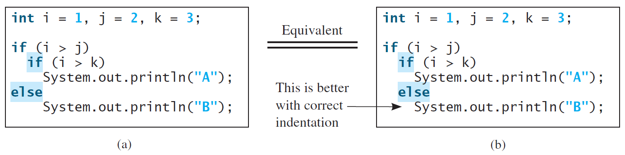
Nested statement
The else clause matches the most recent if clause in the same block.

Slide 37
Note
Nothing is printed from the preceding statement. To force the else clause to match the first if clause, you must add a pair of braces:
int i = 1;
int j = 2;
int k = 3;
if (i > j) {
if (i > k)
System.out.println("A");
}
else
System.out.println("B");
This statement prints B.

Slide 38
Common Errors
Adding a semicolon at the end of an if clause is a common mistake in Java Programming.
if (radius >= 0);
{
area = radius*radius*PI;
System.out.println(
"The area for the circle of radius " +
radius + " is " + area);
}
This mistake is hard to find, because it is not a compilation error or a runtime error, it is a logic error.
This error often occurs when you use the next-line block style.
Block Execution: The block of code enclosed in the {} braces will execute every time, no matter what the if condition evaluates to, because it's no longer connected to the if statement.
Wrong

Slide 39
Without Braces (Incorrect for Multiple Statements):
if (radius >= 0)
area = radius * radius * PI;
System.out.println("The area for the circle of radius " + radius + " is " + area);
Only One Statement Executed Conditionally: In the above code, only the first line after the if statement (area = radius * radius * PI;) is executed if radius >= 0. The second line (System.out.println(...)) will execute unconditionally, regardless of the if condition. This is not what we want.
Correct Version Using Braces:
if (radius >= 0) {
area = radius * radius * PI;
System.out.println("The area for the circle of radius " + radius + " is " + area);
}
Both Statements Executed Conditionally: With braces, both area = radius * radius * PI; and System.out.println(...) are executed only if radius >= 0. This ensures the logic is correct and that both statements are part of the same conditional block.

Slide 40
CAUTION

Slide 41
Problem
You need to write a program that checks whether a number is divisible by 2 and 3, whether a number is divisible by 2 or 3, and whether a number is divisible by 2 or 3 but not both:

Slide 42
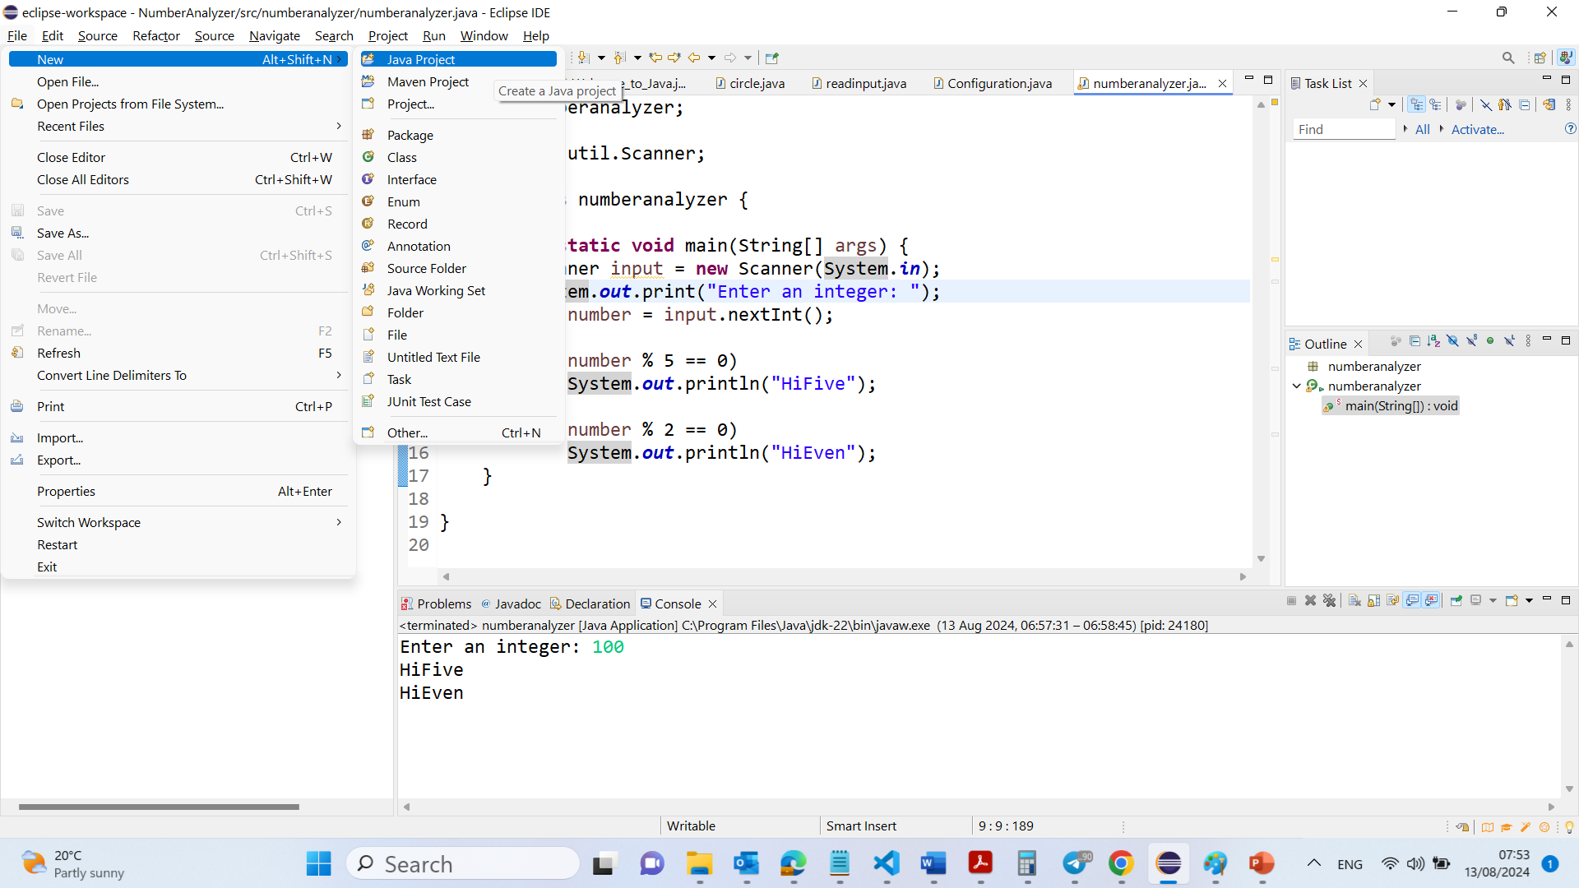

Slide 43
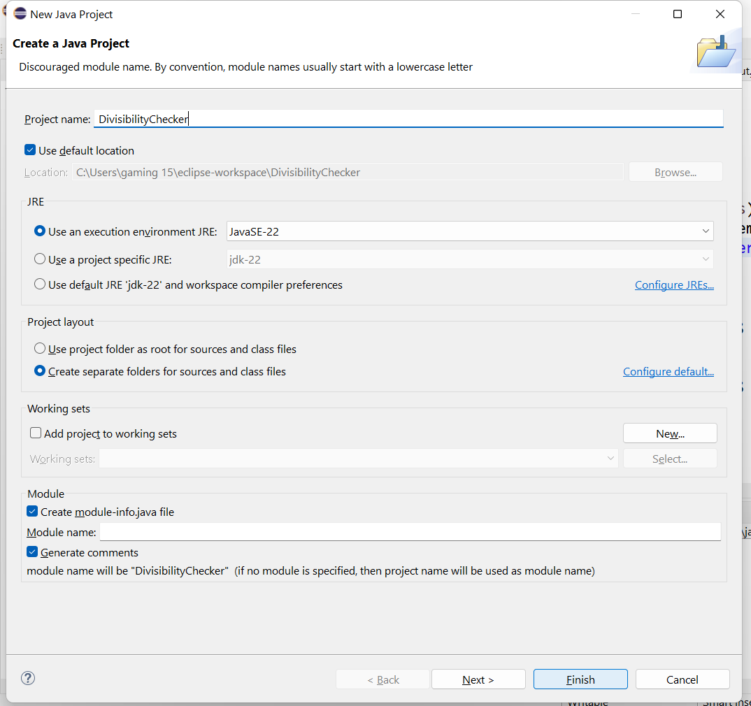

Slide 44
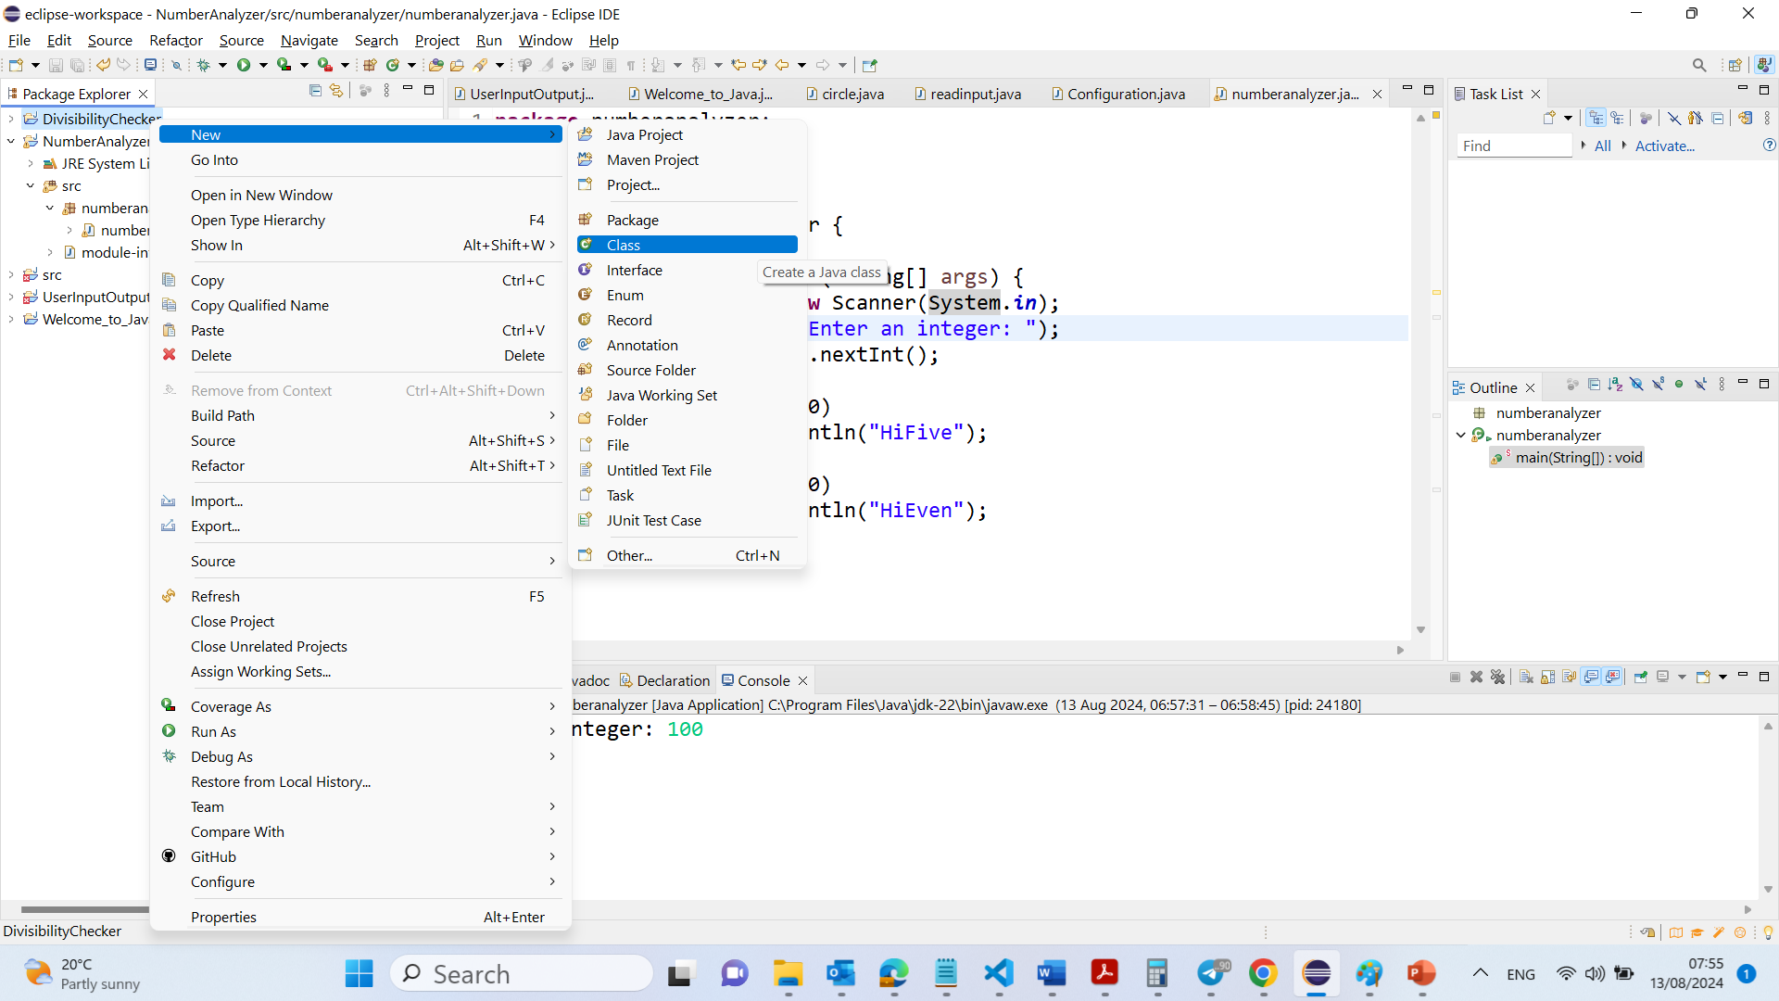

Slide 45
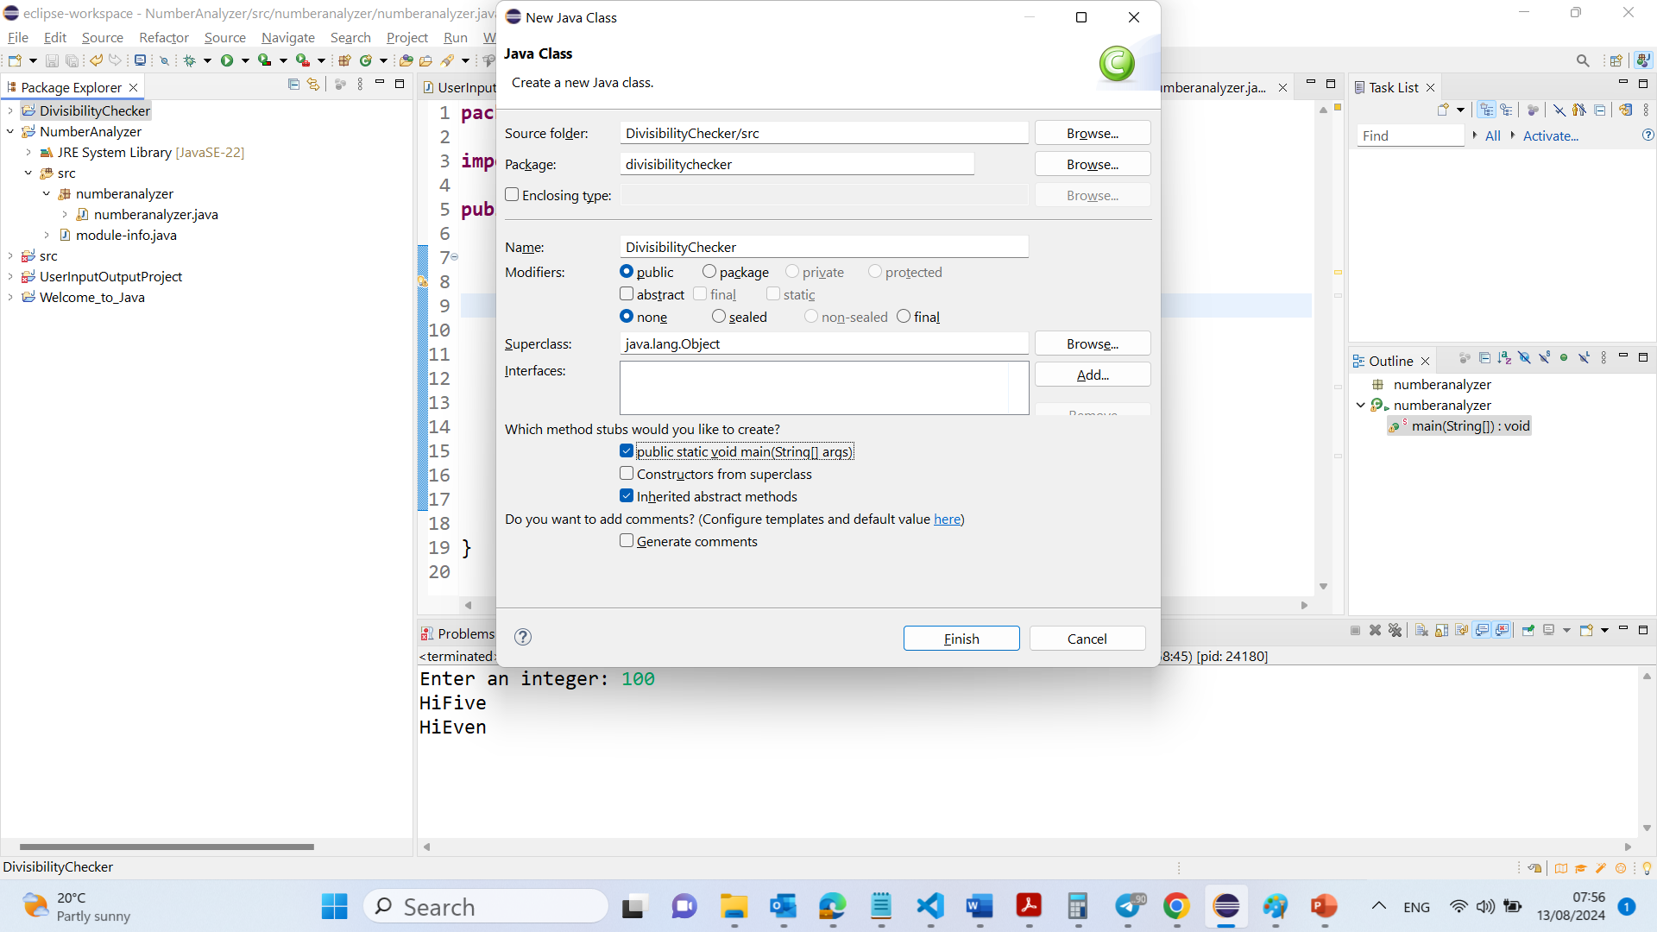

Slide 46
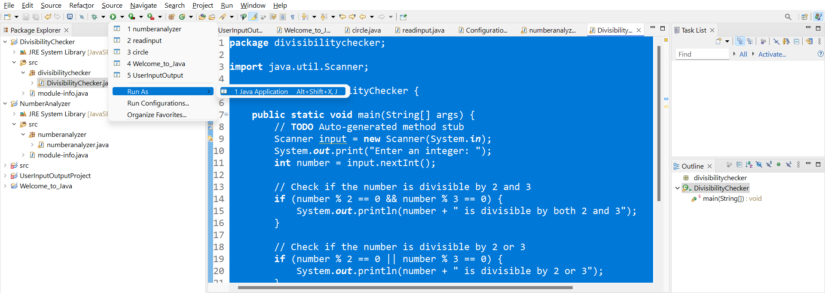

Slide 47
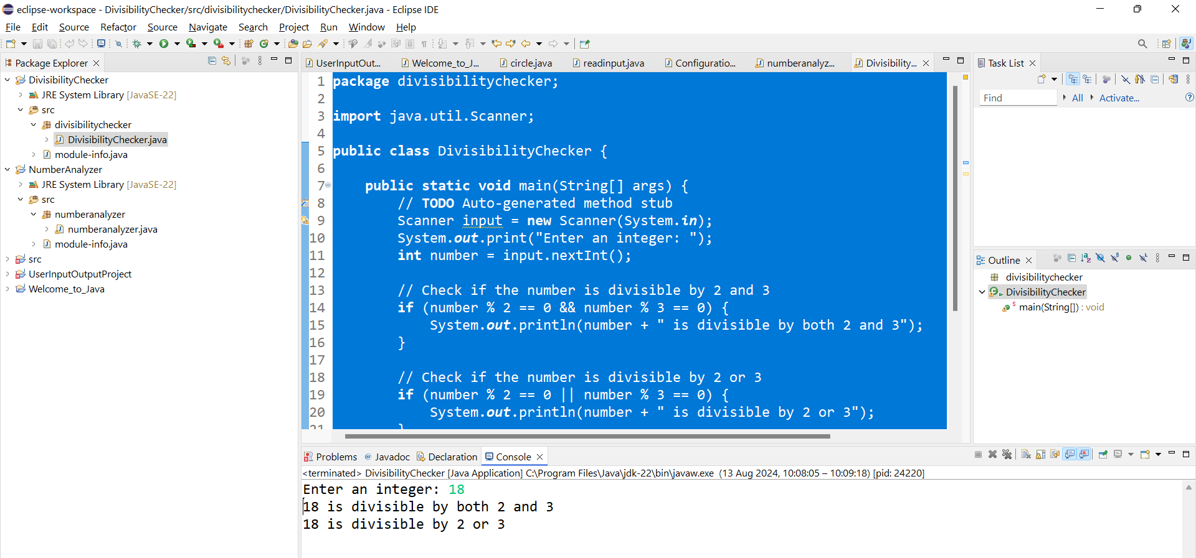

Slide 48
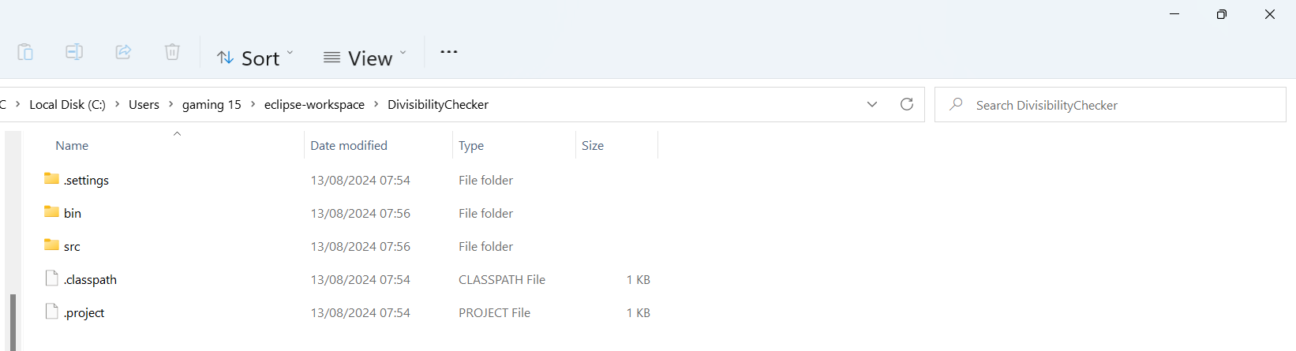
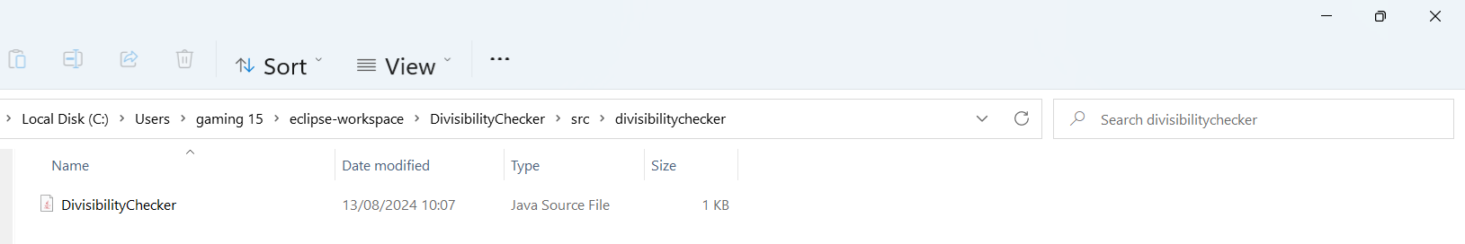
The project will be saved in
C:\Users\...\eclipse-workspace\DivisibilityChecker
The java code is saved in
C:\Users\...\eclipse-workspace\DivisibilityChecker\src\divisibilitychecker

Slide 49
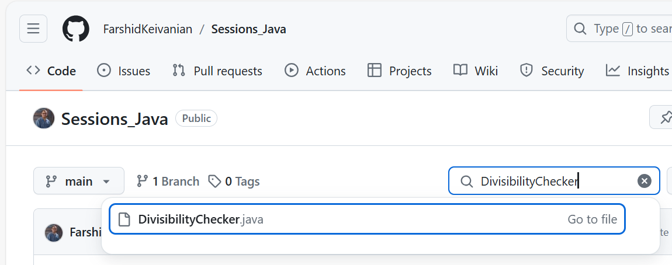
https://github.com/FarshidKeivanian/Sessions_Java

Slide 50
1. Package Declaration: This line declares that the class DivisibilityChecker is part of the divisibilitychecker package. Packages in Java are used to group related classes and interfaces, which helps in organizing large projects and avoiding name conflicts.
package divisibilitychecker;
import java.util.Scanner;
public class DivisibilityChecker {
public static void main(String[] args) {
// TODO Auto-generated method stub
Scanner input = new Scanner(System.in);
System.out.print("Enter an integer: ");
int number = input.nextInt();
// Check if the number is divisible by 2 and 3
if (number % 2 == 0 && number % 3 == 0) {
System.out.println(number + " is divisible by both 2 and 3");
}
// Check if the number is divisible by 2 or 3
if (number % 2 == 0 || number % 3 == 0) {
System.out.println(number + " is divisible by 2 or 3");
}
// Check if the number is divisible by 2 or 3 but not both
if ((number % 2 == 0 || number % 3 == 0) && !(number % 2 == 0 && number % 3 == 0)) {
System.out.println(number + " is divisible by 2 or 3 but not both");
}
}
}

Slide 51
2. Import Statement: This line imports the Scanner class from the java.util package, which is required to read user input. The Scanner class provides methods for reading different types of input, such as strings, integers, and floating-point numbers.
package divisibilitychecker;
import java.util.Scanner;
public class DivisibilityChecker {
public static void main(String[] args) {
// TODO Auto-generated method stub
Scanner input = new Scanner(System.in);
System.out.print("Enter an integer: ");
int number = input.nextInt();
// Check if the number is divisible by 2 and 3
if (number % 2 == 0 && number % 3 == 0) {
System.out.println(number + " is divisible by both 2 and 3");
}
// Check if the number is divisible by 2 or 3
if (number % 2 == 0 || number % 3 == 0) {
System.out.println(number + " is divisible by 2 or 3");
}
// Check if the number is divisible by 2 or 3 but not both
if ((number % 2 == 0 || number % 3 == 0) && !(number % 2 == 0 && number % 3 == 0)) {
System.out.println(number + " is divisible by 2 or 3 but not both");
}
}
}

Slide 52
3. Class Declaration: This line declares a public class named DivisibilityChecker. In Java, a class is a blueprint for creating objects. The public keyword means that this class can be accessed from other classes in different packages.
package divisibilitychecker;
import java.util.Scanner;
public class DivisibilityChecker {
public static void main(String[] args) {
// TODO Auto-generated method stub
Scanner input = new Scanner(System.in);
System.out.print("Enter an integer: ");
int number = input.nextInt();
// Check if the number is divisible by 2 and 3
if (number % 2 == 0 && number % 3 == 0) {
System.out.println(number + " is divisible by both 2 and 3");
}
// Check if the number is divisible by 2 or 3
if (number % 2 == 0 || number % 3 == 0) {
System.out.println(number + " is divisible by 2 or 3");
}
// Check if the number is divisible by 2 or 3 but not both
if ((number % 2 == 0 || number % 3 == 0) && !(number % 2 == 0 && number % 3 == 0)) {
System.out.println(number + " is divisible by 2 or 3 but not both");
}
}
}

Slide 53
4. Main Method: - This is the main method, the entry point of any Java program. When the program is executed, the code inside this method is run.
- public: The method can be called from outside the class.
- static: The method belongs to the class rather than an instance of the class.
- void: The method does not return any value.
- String[] args: This is an array of strings that can store command-line arguments passed to the program.
package divisibilitychecker;
import java.util.Scanner;
public class DivisibilityChecker {
public static void main(String[] args) {
// TODO Auto-generated method stub
Scanner input = new Scanner(System.in);
System.out.print("Enter an integer: ");
int number = input.nextInt();
// Check if the number is divisible by 2 and 3
if (number % 2 == 0 && number % 3 == 0) {
System.out.println(number + " is divisible by both 2 and 3");
}
// Check if the number is divisible by 2 or 3
if (number % 2 == 0 || number % 3 == 0) {
System.out.println(number + " is divisible by 2 or 3");
}
// Check if the number is divisible by 2 or 3 but not both
if ((number % 2 == 0 || number % 3 == 0) && !(number % 2 == 0 && number % 3 == 0)) {
System.out.println(number + " is divisible by 2 or 3 but not both");
}
}
}

Slide 54
package divisibilitychecker;
import java.util.Scanner;
public class DivisibilityChecker {
public static void main(String[] args) {
// TODO Auto-generated method stub
Scanner input = new Scanner(System.in);
System.out.print("Enter an integer: ");
int number = input.nextInt();
// Check if the number is divisible by 2 and 3
if (number % 2 == 0 && number % 3 == 0) {
System.out.println(number + " is divisible by both 2 and 3");
}
// Check if the number is divisible by 2 or 3
if (number % 2 == 0 || number % 3 == 0) {
System.out.println(number + " is divisible by 2 or 3");
}
// Check if the number is divisible by 2 or 3 but not both
if ((number % 2 == 0 || number % 3 == 0) && !(number % 2 == 0 && number % 3 == 0)) {
System.out.println(number + " is divisible by 2 or 3 but not both");
}
}
}
5. Scanner Initialisation: This line creates a Scanner object named input that reads from the standard input stream (System.in), which is typically the keyboard. This allows the program to read user input..

Slide 55
package divisibilitychecker;
import java.util.Scanner;
public class DivisibilityChecker {
public static void main(String[] args) {
// TODO Auto-generated method stub
Scanner input = new Scanner(System.in);
System.out.print("Enter an integer: ");
int number = input.nextInt();
// Check if the number is divisible by 2 and 3
if (number % 2 == 0 && number % 3 == 0) {
System.out.println(number + " is divisible by both 2 and 3");
}
// Check if the number is divisible by 2 or 3
if (number % 2 == 0 || number % 3 == 0) {
System.out.println(number + " is divisible by 2 or 3");
}
// Check if the number is divisible by 2 or 3 but not both
if ((number % 2 == 0 || number % 3 == 0) && !(number % 2 == 0 && number % 3 == 0)) {
System.out.println(number + " is divisible by 2 or 3 but not both");
}
}
}
6. Prompting User for Input: This line prints a message to the console asking the user to "Enter an integer." The print method is used instead of println to keep the cursor on the same line after printing the message.

Slide 56
package divisibilitychecker;
import java.util.Scanner;
public class DivisibilityChecker {
public static void main(String[] args) {
// TODO Auto-generated method stub
Scanner input = new Scanner(System.in);
System.out.print("Enter an integer: ");
int number = input.nextInt();
// Check if the number is divisible by 2 and 3
if (number % 2 == 0 && number % 3 == 0) {
System.out.println(number + " is divisible by both 2 and 3");
}
// Check if the number is divisible by 2 or 3
if (number % 2 == 0 || number % 3 == 0) {
System.out.println(number + " is divisible by 2 or 3");
}
// Check if the number is divisible by 2 or 3 but not both
if ((number % 2 == 0 || number % 3 == 0) && !(number % 2 == 0 && number % 3 == 0)) {
System.out.println(number + " is divisible by 2 or 3 but not both");
}
}
}
7. Reading User Input: This line reads an integer input from the user and stores it in the variable number. The nextInt() method of the Scanner class is used to read the next integer entered by the user.

Slide 57
8. Checking Divisibility by 2 and 3: - This block checks if the number is divisible by both 2 and 3.
- number % 2 == 0 checks if the number is divisible by 2.
- number % 3 == 0 checks if the number is divisible by 3.
- The logical && operator ensures that both conditions must be true for the message to be printed.
package divisibilitychecker;
import java.util.Scanner;
public class DivisibilityChecker {
public static void main(String[] args) {
// TODO Auto-generated method stub
Scanner input = new Scanner(System.in);
System.out.print("Enter an integer: ");
int number = input.nextInt();
// Check if the number is divisible by 2 and 3
if (number % 2 == 0 && number % 3 == 0) {
System.out.println(number + " is divisible by both 2 and 3");
}
// Check if the number is divisible by 2 or 3
if (number % 2 == 0 || number % 3 == 0) {
System.out.println(number + " is divisible by 2 or 3");
}
// Check if the number is divisible by 2 or 3 but not both
if ((number % 2 == 0 || number % 3 == 0) && !(number % 2 == 0 && number % 3 == 0)) {
System.out.println(number + " is divisible by 2 or 3 but not both");
}
}
}

Slide 58
package divisibilitychecker;
import java.util.Scanner;
public class DivisibilityChecker {
public static void main(String[] args) {
// TODO Auto-generated method stub
Scanner input = new Scanner(System.in);
System.out.print("Enter an integer: ");
int number = input.nextInt();
// Check if the number is divisible by 2 and 3
if (number % 2 == 0 && number % 3 == 0) {
System.out.println(number + " is divisible by both 2 and 3");
}
// Check if the number is divisible by 2 or 3
if (number % 2 == 0 || number % 3 == 0) {
System.out.println(number + " is divisible by 2 or 3");
}
// Check if the number is divisible by 2 or 3 but not both
if ((number % 2 == 0 || number % 3 == 0) && !(number % 2 == 0 && number % 3 == 0)) {
System.out.println(number + " is divisible by 2 or 3 but not both");
}
}
}
9. Checking Divisibility by 2 or 3: - This block checks if the number is divisible by either 2 or 3.
- The logical || operator ensures that if either condition is true, the message will be printed.

Slide 59
10. Checking Divisibility by 2 or 3 but Not Both: - This block checks if the number is divisible by 2 or 3 but not both.
The first part (number % 2 == 0 || number % 3 == 0) checks if the number is divisible by 2 or 3.
The second part !(number % 2 == 0 && number % 3 == 0) uses the negation ! operator to ensure that the number is not divisible by both 2 and 3 simultaneously.
The combination of these two conditions ensures that the number is divisible by either 2 or 3, but not both.
package divisibilitychecker;
import java.util.Scanner;
public class DivisibilityChecker {
public static void main(String[] args) {
// TODO Auto-generated method stub
Scanner input = new Scanner(System.in);
System.out.print("Enter an integer: ");
int number = input.nextInt();
// Check if the number is divisible by 2 and 3
if (number % 2 == 0 && number % 3 == 0) {
System.out.println(number + " is divisible by both 2 and 3");
}
// Check if the number is divisible by 2 or 3
if (number % 2 == 0 || number % 3 == 0) {
System.out.println(number + " is divisible by 2 or 3");
}
// Check if the number is divisible by 2 or 3 but not both
if ((number % 2 == 0 || number % 3 == 0) && !(number % 2 == 0 && number % 3 == 0)) {
System.out.println(number + " is divisible by 2 or 3 but not both");
}
}
}

Slide 60
package divisibilitychecker;
import java.util.Scanner;
public class DivisibilityChecker {
public static void main(String[] args) {
// TODO Auto-generated method stub
Scanner input = new Scanner(System.in);
System.out.print("Enter an integer: ");
int number = input.nextInt();
// Check if the number is divisible by 2 and 3
if (number % 2 == 0 && number % 3 == 0) {
System.out.println(number + " is divisible by both 2 and 3");
}
// Check if the number is divisible by 2 or 3
if (number % 2 == 0 || number % 3 == 0) {
System.out.println(number + " is divisible by 2 or 3");
}
// Check if the number is divisible by 2 or 3 but not both
if ((number % 2 == 0 || number % 3 == 0) && !(number % 2 == 0 && number % 3 == 0)) {
System.out.println(number + " is divisible by 2 or 3 but not both");
}
}
}
11. Closing the Main Method and Class: - The closing braces } mark the end of the main method and the DivisibilityChecker class. Every block of code in Java (like methods, classes, and loops) is enclosed within curly braces {}.

Slide 61
Logical Operators
Operator | Name | Description
! | not | logical negation
&& | and | logical conjunction
|| | or | logical disjunction
^ | exclusive or | logical exclusion

Slide 62
Short Solution
System.out.println("Is " + number + " divisible by 2 and 3? " +
((number % 2 == 0) && (number % 3 == 0)));
System.out.println("Is " + number + " divisible by 2 or 3? " +
((number % 2 == 0) || (number % 3 == 0)));
System.out.println("Is " + number +
" divisible by 2 or 3, but not both? " +
((number % 2 == 0) ^ (number % 3 == 0)));
TestBooleanOperators

Slide 63
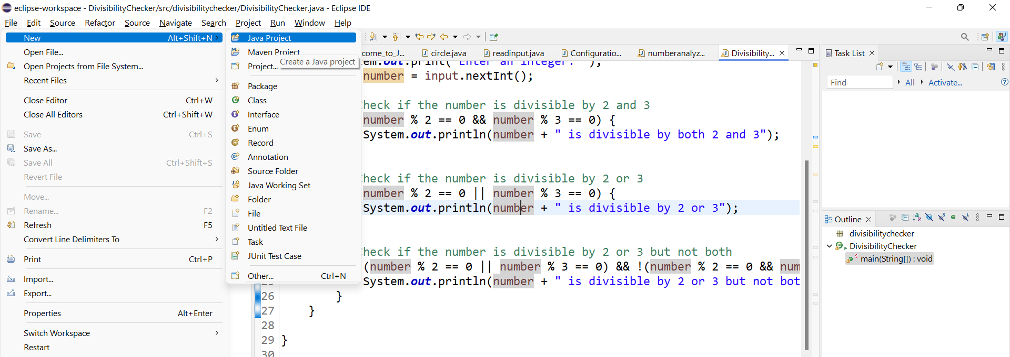

Slide 64
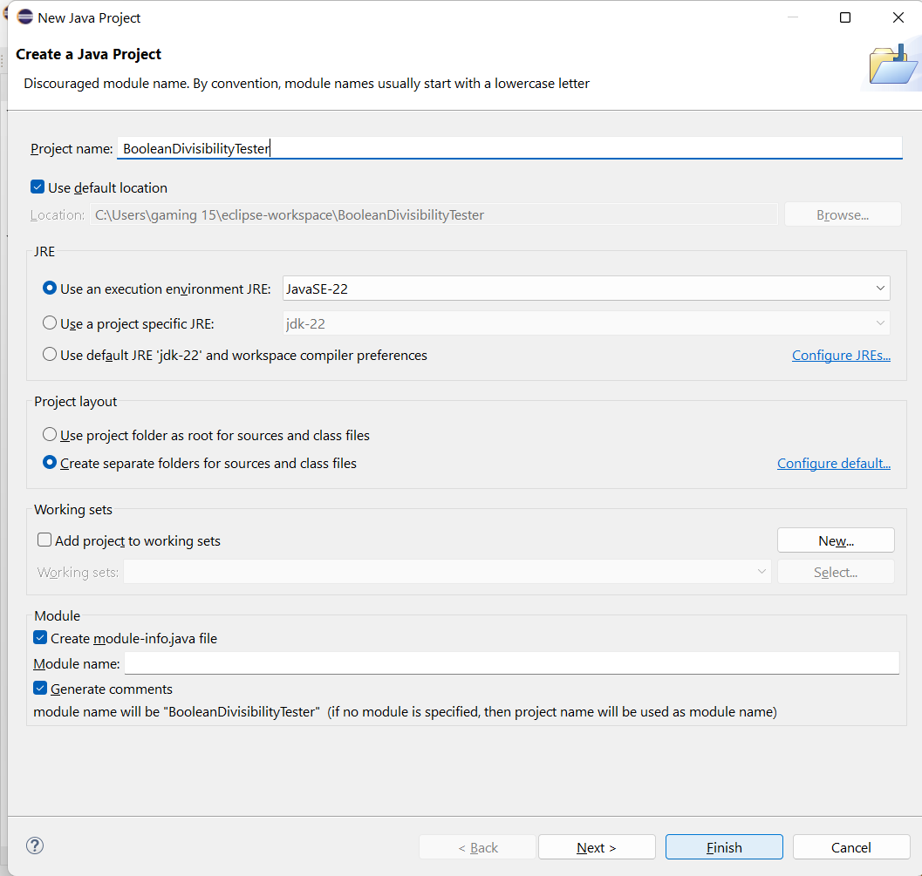

Slide 65
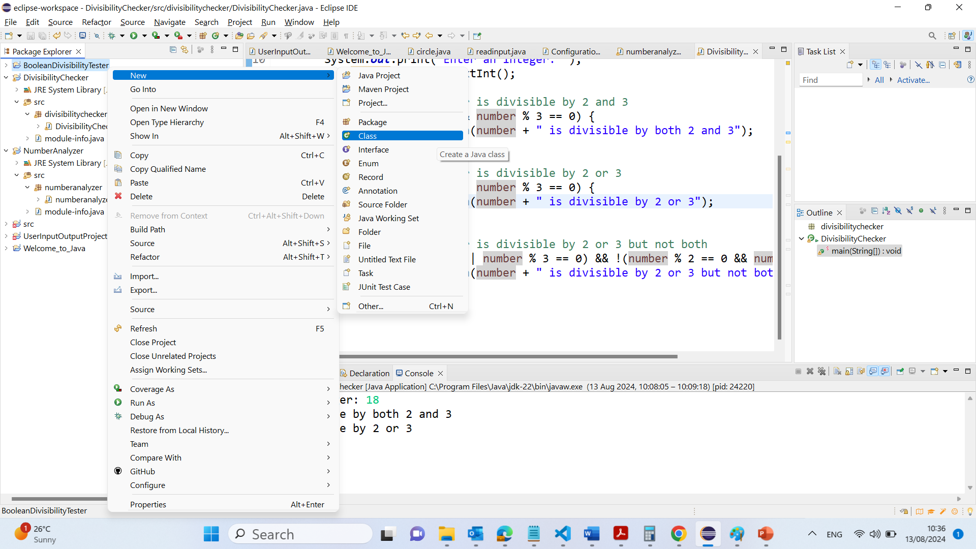

Slide 66
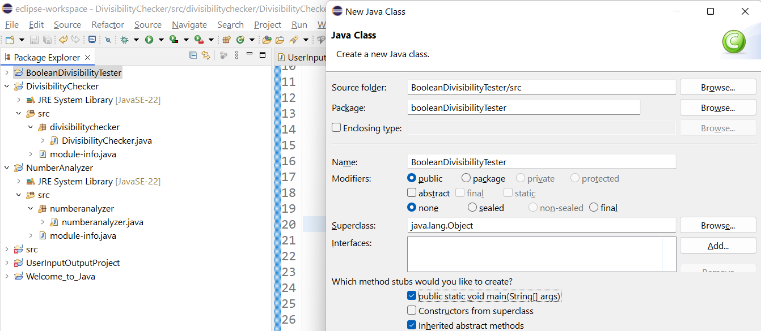
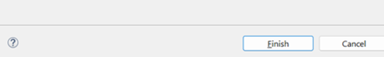

Slide 67
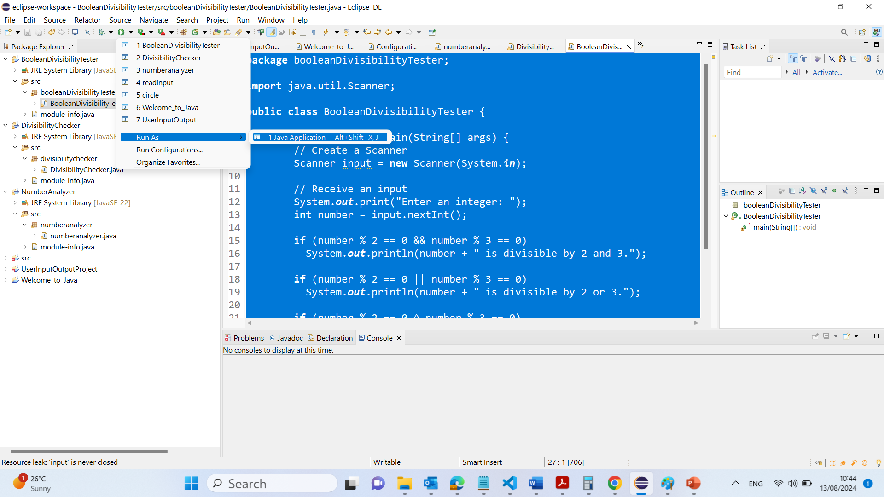

Slide 68
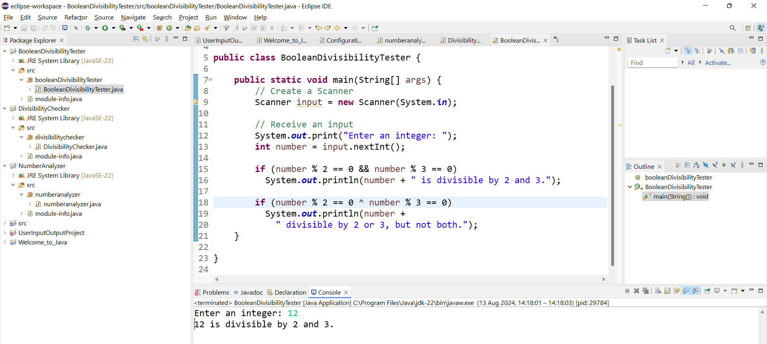

Slide 69
package booleanDivisibilityTester;
import java.util.Scanner;
public class BooleanDivisibilityTester {
public static void main(String[] args) {
// Create a Scanner
Scanner input = new Scanner(System.in);
// Receive an input
System.out.print("Enter an integer: ");
int number = input.nextInt();
if (number % 2 == 0 && number % 3 == 0)
System.out.println(number + " is divisible by 2 and 3.");
if (number % 2 == 0 ^ number % 3 == 0)
System.out.println(number +
" divisible by 2 or 3, but not both.");
}
}
1. Conditional Statement (if):
The if statement evaluates a condition and executes the code block inside it only if the condition is true.
2. Modulo Operator (%):
The modulo operator (%) is used to find the remainder when number is divided by another number. For example, number % 2 checks if the number is divisible by 2.
number % 2 == 0 checks if the number is divisible by 2 (i.e., if there is no remainder).
Similarly, number % 3 == 0 checks if the number is divisible by 3.

Slide 70
package booleanDivisibilityTester;
import java.util.Scanner;
public class BooleanDivisibilityTester {
public static void main(String[] args) {
// Create a Scanner
Scanner input = new Scanner(System.in);
// Receive an input
System.out.print("Enter an integer: ");
int number = input.nextInt();
if (number % 2 == 0 && number % 3 == 0)
System.out.println(number + " is divisible by 2 and 3.");
if (number % 2 == 0 ^ number % 3 == 0)
System.out.println(number +
" divisible by 2 or 3, but not both.");
}
}
3. Exclusive OR Operator (^):
The ^ operator is the exclusive OR (XOR) operator in Java.
In the context of Boolean values, A ^ B returns true if and only if one of the operands (A or B) is true, but not both.
So, number % 2 == 0 ^ number % 3 == 0 checks if the number is divisible by either 2 or 3, but not both. This condition will be true if the number is divisible by 2 and not by 3, or if it is divisible by 3 and not by 2.

Slide 71
package booleanDivisibilityTester;
import java.util.Scanner;
public class BooleanDivisibilityTester {
public static void main(String[] args) {
// Create a Scanner
Scanner input = new Scanner(System.in);
// Receive an input
System.out.print("Enter an integer: ");
int number = input.nextInt();
if (number % 2 == 0 && number % 3 == 0)
System.out.println(number + " is divisible by 2 and 3.");
if (number % 2 == 0 ^ number % 3 == 0)
System.out.println(number +
" divisible by 2 or 3, but not both.");
}
}
4. Printing the Result:
If the condition is true, the program prints out a message saying the number is "divisible by 2 or 3, but not both."

Slide 72
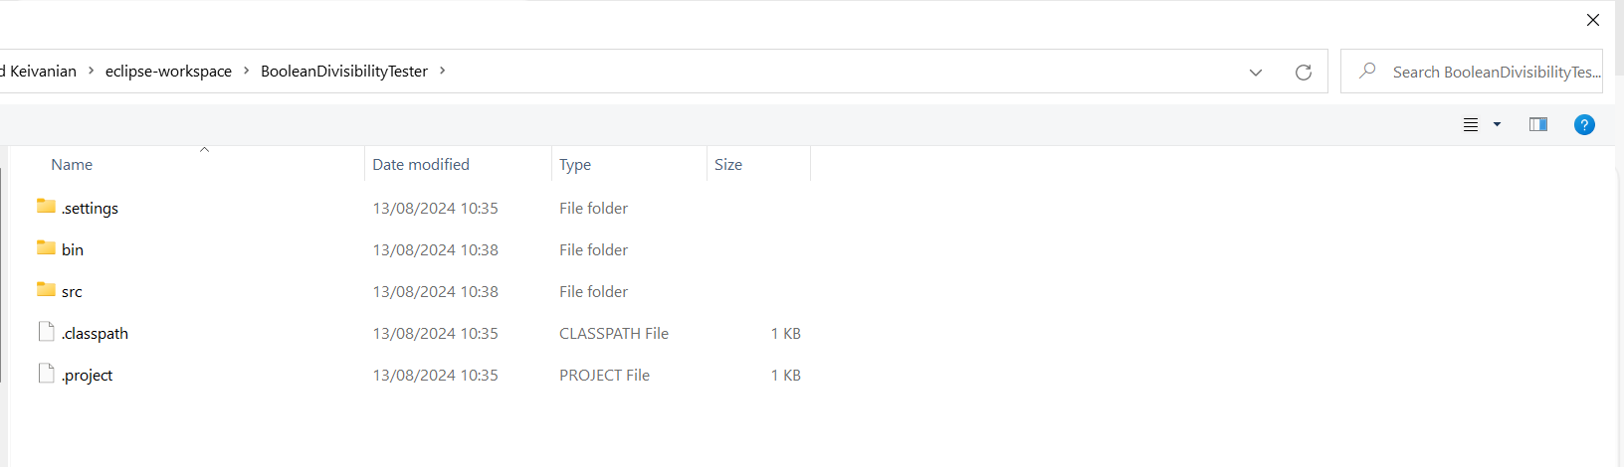
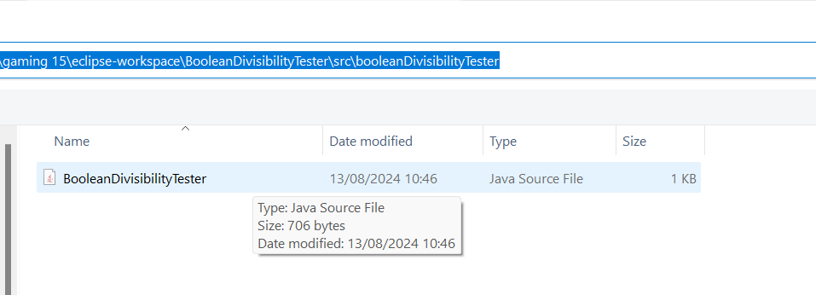
The project is saved on C:\Users\...\eclipse-workspace\BooleanDivisibilityTester
The code is saved on C:\Users\...\eclipse-workspace\BooleanDivisibilityTester\src\booleanDivisibilityTester

Slide 73
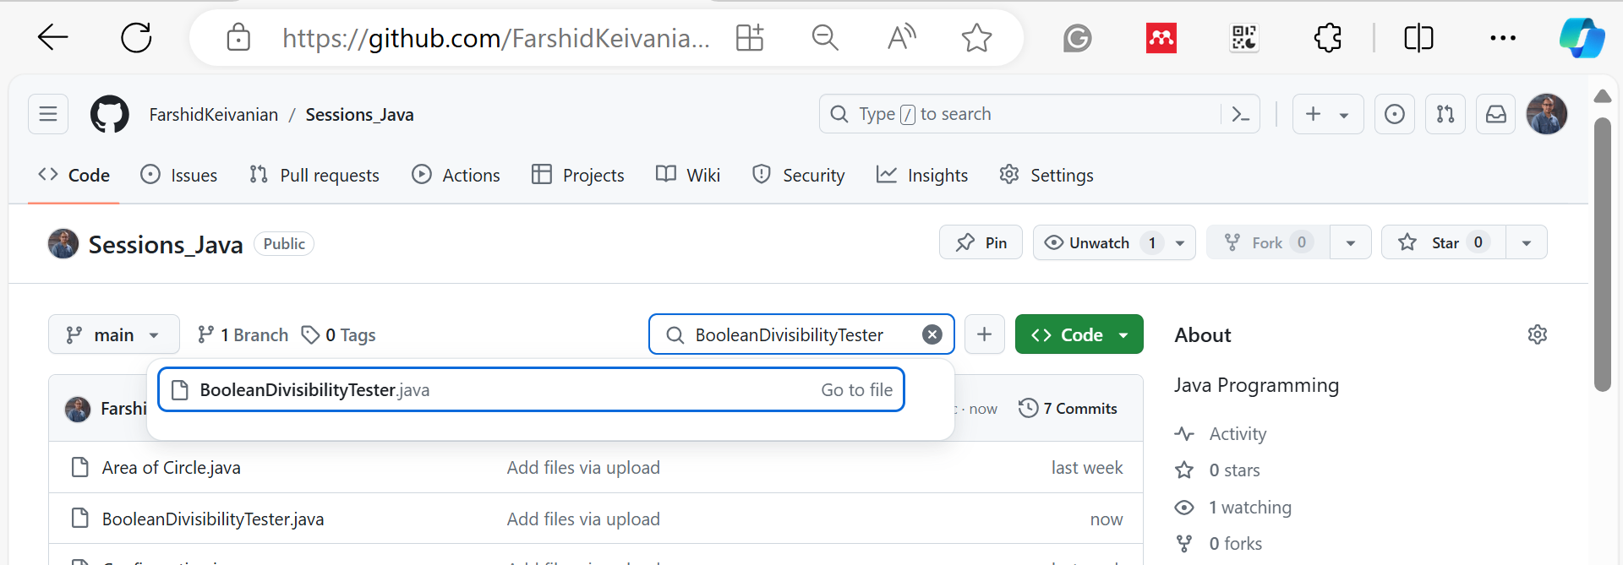
https://github.com/FarshidKeivanian/Sessions_Java

Slide 74
Truth Table for Operator !
p | !p | Example (assume age = 24, weight = 140)
true | false | !(age > 18) is false, because (age > 18) is true.
false | true | !(weight == 150) is true, because (weight == 150) is false.
For example: !(Age < 18) checks if the age is not less than 18 for driving licence

Slide 75
Truth Table for Operator &&
p₁ | p₂ | p₁ && p₂ | Example (assume age = 24, weight = 140)
false | false | false | (age <= 18) && (weight < 140) is false, because both conditions are both false.
false | true | false
true | false | false | (age > 18) && (weight > 140) is false, because (weight > 140) is false.
true | true | true | (age > 18) && (weight >= 140) is true, because both (age > 18) and (weight >= 140) are true.

Slide 76
Truth Table for Operator ||
p₁ | p₂ | p₁ || p₂ | Example (assume age = 24, weight = 140)
false | false | false
false | true | true | (age > 34) || (weight <= 140) is true, because (age > 34) is false, but (weight <= 140) is true.
true | false | true | (age > 14) || (weight >= 150) is false, because (age > 14) is true.
true | true | true

Slide 77
Truth Table for Operator ^
p₁ | p₂ | p₁ ^ p₂ | Example (assume age = 24, weight = 140)
false | false | false | (age > 34) ^ (weight > 140) is true, because (age > 34) is false and (weight > 140) is false.
false | true | true | (age > 34) ^ (weight >= 140) is true, because (age > 34) is false but (weight >= 140) is true.
true | false | true | (age > 14) ^ (weight > 140) is true, because (age > 14) is true and (weight > 140) is false.
true | true | false
In the context of Boolean values, A ^ B returns true if and only if one of the operands (A or B) is true, but not both.

Slide 78
Problem: Determining Leap Year?
This program first prompts the user to enter a year as an int value and checks if it is a leap year.
A year is a leap year if it is divisible by 4 but not by 100, or it is divisible by 400.
(year % 4 == 0 && year % 100 != 0) || (year % 400 == 0)
LeapYear

Slide 79
Conditional Operators
if (x > 0)
y = 1
else
y = -1;
is equivalent to
y = (x > 0) ? 1 : -1;
(boolean-expression) ? expression1 : expression2

Slide 80
Conditional Operator
if (num % 2 == 0)
System.out.println(num + “is even”);
else
System.out.println(num + “is odd”);
System.out.println(
(num % 2 == 0)? num + “is even” :
num + “is odd”);

Slide 81
Conditional Operator, cont.
boolean-expression ? exp1 : exp2

Slide 82
Operator Precedence
var++, var--
+, - (Unary plus and minus), ++var,--var
(type) Casting
! (Not)
*, /, % (Multiplication, division, and remainder)
+, - (Binary addition and subtraction)
<, <=, >, >= (Relational operators)
==, !=; (Equality)
^ (Exclusive OR)
&& (Conditional AND) Short-circuit AND
|| (Conditional OR) Short-circuit OR
=, +=, -=, *=, /=, %= (Assignment operator)
var++ (Post-Increment):
Increments the value of var by 1, but the original value of var is used in the expression before the increment.
int var = 5;
int result = var++; // result is 5, var is now 6

Slide 83
Operator Precedence
var++, var--
+, - (Unary plus and minus), ++var,--var
(type) Casting
! (Not)
*, /, % (Multiplication, division, and remainder)
+, - (Binary addition and subtraction)
<, <=, >, >= (Relational operators)
==, !=; (Equality)
^ (Exclusive OR)
&& (Conditional AND) Short-circuit AND
|| (Conditional OR) Short-circuit OR
=, +=, -=, *=, /=, %= (Assignment operator)
Narrowing Cast (Explicit):
* Manually converting a larger type to a smaller type, which may result in loss of precision or data (e.g., double to int).
double d = 9.78;
int i = (int) d; // i is now 9, decimal part is lost

Slide 84
Operator Precedence and Associativity
The expression in the parentheses is evaluated first. (Parentheses can be nested, in which case the expression in the inner parentheses is executed first.)
When evaluating an expression without parentheses, the operators are applied according to the precedence rule and the associativity rule.
If operators with the same precedence are next to each other, their associativity determines the order of evaluation. All binary operators except assignment operators are left-associative.

Slide 85
Operator Associativity
When two operators with the same precedence are evaluated, the associativity of the operators determines the order of evaluation. All binary operators except assignment operators are left-associative.
a – b + c – d is equivalent to ((a – b) + c) – d
Assignment operators are right-associative. Therefore, the expression
a = b += c = 5 is equivalent to a = (b += (c = 5))

Slide 86
Example
Applying the operator precedence and associativity rule, the expression 3 + 4 * 4 > 5 * (4 + 3) - 1 is evaluated as follows:

Slide 87
Opening Problem
Problem:
System.out.println("Welcome to Java!");
System.out.println("Welcome to Java!");
System.out.println("Welcome to Java!");
System.out.println("Welcome to Java!");
System.out.println("Welcome to Java!");
System.out.println("Welcome to Java!");
…
…
…
System.out.println("Welcome to Java!");
System.out.println("Welcome to Java!");
System.out.println("Welcome to Java!");
100 times

Slide 88
Introducing while Loops
int count = 0;
while (count < 100) {
System.out.println("Welcome to Java");
count++;
}

Slide 89
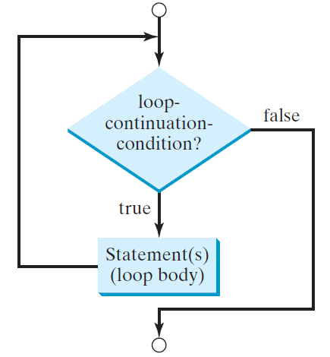
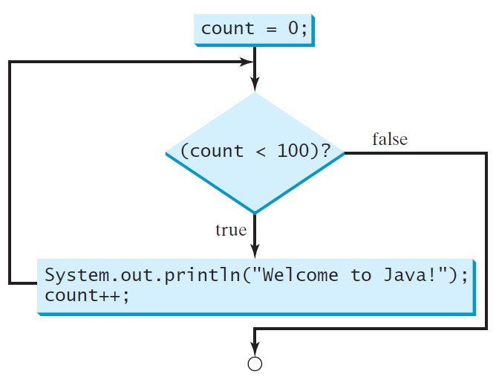
while Loop Flow Chart
int count = 0;
while (count < 100) {
System.out.println("Welcome to Java!");
count++;
}
while (loop-continuation-condition) {
// loop-body;
Statement(s);
}

Slide 90
Trace while Loop
Initialize count
int count = 0;
while (count < 2) {
System.out.println("Welcome to Java!");
count++;
}

Slide 91
Trace while Loop, cont.
(count < 2) is true
int count = 0;
while (count < 2) {
System.out.println("Welcome to Java!");
count++;
}

Slide 92
Trace while Loop, cont.
Print Welcome to Java
int count = 0;
while (count < 2) {
System.out.println("Welcome to Java!");
count++;
}

Slide 93
Trace while Loop, cont.
Increase count by 1
count is 1 now
int count = 0;
while (count < 2) {
System.out.println("Welcome to Java!");
count++;
}

Slide 94
Trace while Loop, cont.
(count < 2) is still true since count is 1
int count = 0;
while (count < 2) {
System.out.println("Welcome to Java!");
count++;
}

Slide 95
Trace while Loop, cont.
Print Welcome to Java
int count = 0;
while (count < 2) {
System.out.println("Welcome to Java!");
count++;
}

Slide 96
Trace while Loop, cont.
Increase count by 1
count is 2 now
int count = 0;
while (count < 2) {
System.out.println("Welcome to Java!");
count++;
}

Slide 97
Trace while Loop, cont.
(count < 2) is false since count is 2 now
int count = 0;
while (count < 2) {
System.out.println("Welcome to Java!");
count++;
}

Slide 98
Trace while Loop
The loop exits. Execute the next statement after the loop.
int count = 0;
while (count < 2) {
System.out.println("Welcome to Java!");
count++;
}

Slide 99
Caution
Don’t use floating-point values for equality checking in a loop control. Since floating-point values are approximations for some values, using them could result in imprecise counter values and inaccurate results. Consider the following code for computing 1 + 0.9 + 0.8 + ... + 0.1:
double item = 1; double sum = 0;
while (item != 0) { // No guarantee item will be 0
sum += item;
item -= 0.1;
}
System.out.println(sum);

Slide 100
Correct Sum
Avoid equality checks with floating-point numbers in loops because they can lead to inaccuracies due to the imprecise representation of some floating-point values; instead, use a condition like item >= 0 to ensure the loop terminates correctly.
double item = 1; double sum = 0;
while (item >= 0) {
sum += item;
item -= 0.1;
}
System.out.println(sum);

Slide 101
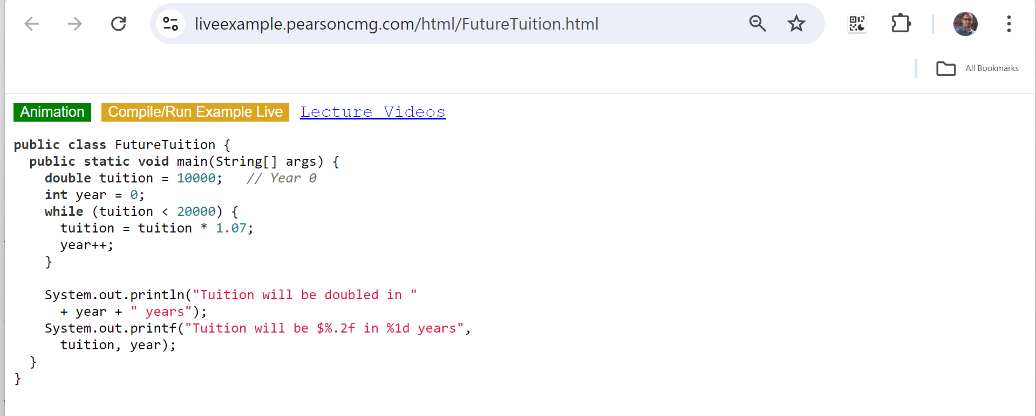
Problem: Predicting the Future Tuition
Problem: Suppose that the tuition for a university is $10,000 this year and tuition increases 7% every year. In how many years will the tuition be doubled?
1. Class Declaration: This line declares a public class named FutureTuition. In Java, a class is a blueprint for creating objects and organizing code. The public keyword indicates that this class can be accessed from outside its package.
FutureTuition

Slide 102
Problem: Predicting the Future Tuition
Problem: Suppose that the tuition for a university is $10,000 this year and tuition increases 7% every year. In how many years will the tuition be doubled?
2. Main Method:
This is the main method, the entry point of any Java application. When the program is run, the code inside this method will execute.
public: The method can be called from outside the class.
static: The method belongs to the class rather than an instance of the class.
void: The method does not return any value.
String[] args: This is an array of strings that stores command-line arguments passed to the program.
FutureTuition

Slide 103
Problem: Predicting the Future Tuition
Problem: Suppose that the tuition for a university is $10,000 this year and tuition increases 7% every year. In how many years will the tuition be doubled?
3. Initial Tuition and Year Variables:
tuition = 10000;: This line initializes the tuition variable to $10,000, representing the initial tuition cost in the first year.
int year = 0;: This line initializes the year variable to 0, representing the starting point (Year 0) in the loop.
FutureTuition

Slide 104
Problem: Predicting the Future Tuition
Problem: Suppose that the tuition for a university is $10,000 this year and tuition increases 7% every year. In how many years will the tuition be doubled?
4. While Loop:
while (tuition < 20000): This loop continues as long as the tuition is less than $20,000.
tuition = tuition * 1.07;: Inside the loop, tuition is increased by 7% each year. Multiplying the current tuition by 1.07 simulates this 7% increase.
year++;: The year variable is incremented by 1 each time the loop runs, representing the passing of one year.
FutureTuition

Slide 105
Problem: Predicting the Future Tuition
Problem: Suppose that the tuition for a university is $10,000 this year and tuition increases 7% every year. In how many years will the tuition be doubled?
5. Printing the Number of Years:
This line prints the number of years it takes for the tuition to double. The text "Tuition will be doubled in " is concatenated with the value of year and " years".
For example, if year is 10, the output will be: Tuition will be doubled in 10 years
FutureTuition

Slide 106
Problem: Predicting the Future Tuition
Problem: Suppose that the tuition for a university is $10,000 this year and tuition increases 7% every year. In how many years will the tuition be doubled?
6. Formatted Tuition Output:
System.out.printf is used to print formatted output.
"Tuition will be $%.2f in %1d years" is the format string:
%.2f formats the tuition variable as a floating-point number with two decimal places.
%1d formats the year variable as an integer.
This line prints the exact tuition amount after it has doubled, along with the number of years it took to reach that amount.
FutureTuition

Slide 107
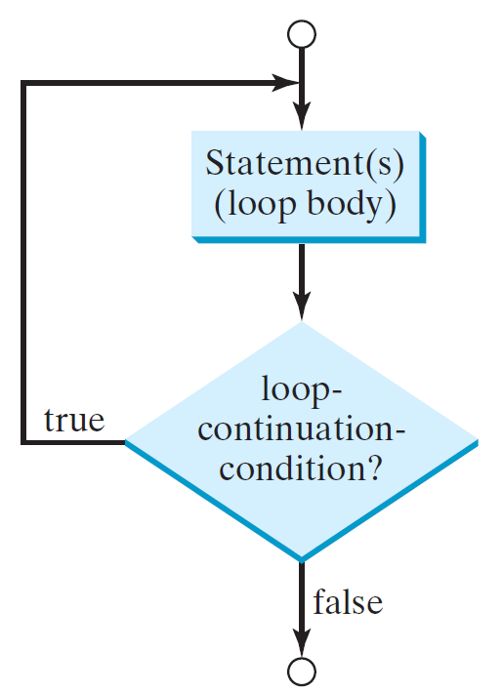
do-while Loop
do {
// Loop body;
Statement(s);
} while (loop-continuation-condition);
int count = 0;
do {
System.out.println("Welcome to Java!");
count++;
}
while (count < 0);
The do-while loop in Java will execute the loop body at least once before checking the loop continuation condition, ensuring the loop body runs even if the condition is initially false

Slide 108
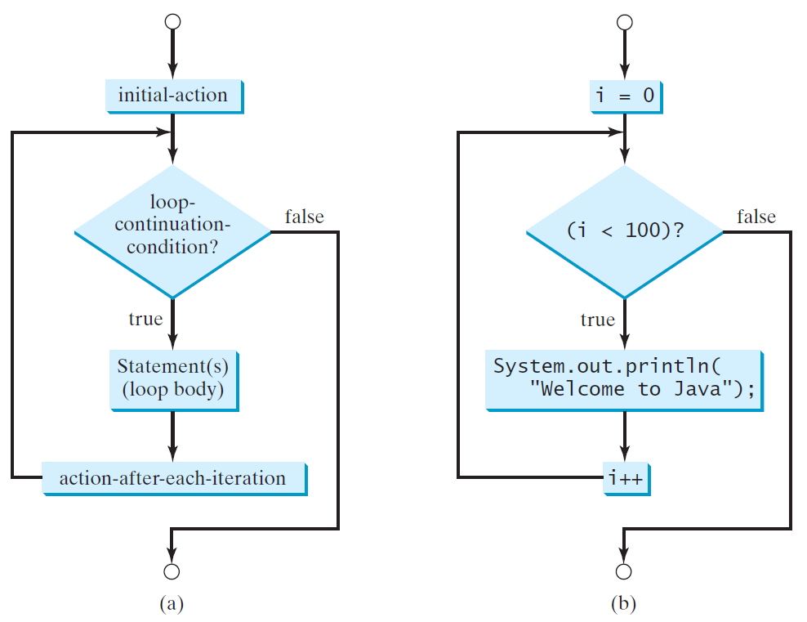
for Loops
for (initial-action; loop-continuation-condition; action-after-each-iteration) {
// loop body;
Statement(s);
}
int i;
for (i = 0; i < 100; i++) {
System.out.println(
"Welcome to Java!");
}

Slide 109
Trace for Loop
Declare i
int i;
for (i = 0; i < 2; i++) {
System.out.println(
"Welcome to Java!");
}

Slide 110
Trace for Loop, cont.
Execute initializer
i is now 0
int i;
for (i = 0; i < 2; i++) {
System.out.println(
"Welcome to Java!");
}

Slide 111
Trace for Loop, cont.
(i < 2) is true
since i is 0
int i;
for (i = 0; i < 2; i++) {
System.out.println( "Welcome to Java!");
}

Slide 112
Trace for Loop, cont
Print Welcome to Java
int i;
for (i = 0; i < 2; i++) {
System.out.println(
"Welcome to Java!");
}

Slide 113
Trace for Loop, cont.
Execute adjustment statement
i now is 1
int i;
for (i = 0; i < 2; i++) {
System.out.println("Welcome to Java!");
}

Slide 114
Trace for Loop, cont.
(i < 2) is still true
since i is 1
int i;
for (i = 0; i < 2; i++) {
System.out.println("Welcome to Java!");
}

Slide 115
Trace for Loop, cont.
Print Welcome to Java
int i;
for (i = 0; i < 2; i++) {
System.out.println("Welcome to Java!");
}

Slide 116
Trace for Loop, cont.
Execute adjustment statement
i now is 2
int i;
for (i = 0; i < 2; i++) {
System.out.println("Welcome to Java!");
}

Slide 117
Trace for Loop, cont.
(i < 2) is false
since i is 2
int i;
for (i = 0; i < 2; i++) {
System.out.println("Welcome to Java!");
}

Slide 118
Trace for Loop, cont.
int i;
for (i = 0; i < 2; i++) {
System.out.println("Welcome to Java!");
}
Exit the loop. Execute the next statement after the loop

Slide 119
Conditional For-loop Sum Example
double sum = 0;
for (double item = 1; item >= 0; item-=0.1) {
if (item >= 0.5)
sum += item;
}
System.out.println(sum);
This code uses a for loop to sum all values of item starting from 1 down to 0 in decrements of 0.1, but only adds item to sum when item is greater than or equal to 0.5, and then prints the final sum.

Slide 120
Note
The initial-action in a for loop can be a list of zero or more comma-separated expressions.
The action-after-each-iteration in a for loop can be a list of zero or more comma-separated statements.
Therefore, the following two for loops are correct. They are rarely used in practice, however.
for (int i = 1; i < 100; System.out.println(i++));
for (int i = 0, j = 0; (i + j < 10); i++, j++) {
// Do something
}
In a for loop, both the initialization (initial-action) and the action after each iteration (action-after-each-iteration) can include multiple comma-separated statements. While this is syntactically correct in Java, it's rarely used in practice due to readability concerns. The slide provides two examples of such for loops, demonstrating this capability.

Slide 121
Note
If the loop-continuation-condition in a for loop is omitted, it is implicitly true. Thus the statement given below in (a), which is an infinite loop, is correct. Nevertheless, it is better to use the equivalent loop in (b) to avoid confusion:
If the loop continuation condition in a for loop is omitted, the loop will run indefinitely because the condition is implicitly considered true, leading to an infinite loop. The slide shows two equivalent ways to write an infinite loop: (a) using a for loop with empty conditions, and (b) using a while (true) loop. Although both are correct, the while (true) loop (b) is preferred for clarity and to avoid confusion.

Slide 122
Caution
Adding a semicolon at the end of the for clause before the loop body is a common mistake, as shown below:
Logic Error
for (int i=0; i<10; i++);
{
System.out.println("i is " + i);
}
We warn against the common mistake of adding a semicolon immediately after the for loop declaration, before the loop body. This semicolon effectively terminates the for loop, making the loop body (the code inside the braces {}) independent of the loop. As a result, the loop runs without executing the intended code block, leading to a logic error where the code inside the loop doesn't behave as expected. In this case, the loop increments i from 0 to 10 without executing System.out.println("i is " + i);

Slide 123
Caution, cont.
Similarly, the following loop is also wrong:
int i=0;
while (i < 10);
{
System.out.println("i is " + i);
i++;
}
In the case of the do while loop, the following semicolon is needed to end the loop.
int i=0;
do {
System.out.println("i is " + i);
i++;
} while (i<10);
Logic Error
Correct

Slide 124
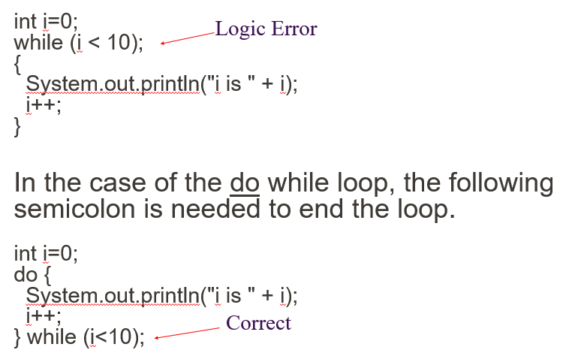
First Example (Incorrect while Loop): The code shows a while loop where a semicolon is mistakenly placed immediately after the loop condition (while (i < 10);). This creates a logic error because the semicolon effectively ends the loop, making the loop body (the code inside the braces {}) independent of the while condition. As a result, the loop increments i without executing the intended code block.
Second Example (do-while Loop, Correct Usage): In contrast, the do-while loop shown below is correctly using a semicolon at the end of the loop, which is required syntax. In a do-while loop, the semicolon after the while condition is necessary to signify the end of the loop. The do-while loop correctly executes the loop body first and then checks the condition, ensuring the loop behaves as expected.

Slide 125
Next week
After class TODO list:
Review the lecture
Read book chapter
Attend lab
Attempt assessment
Program Control Structures: Selections and Loops II
Program core constructs

